Slide 1
Indonesian online extremism
Latest trends and techniques
Mark Wilson
Jane’s Intelligence Unit
June 2019

Slide 2
My background
Joined Jane’s in 2018
BBC Monitoring, Jihadist Media Monitoring Unit
Journalist based in Southeast Asia covering terrorism, organized crime
UK govt policy officer working on preventing violent extremism

Slide 3
Jane’s Intelligence Unit: Four Key Capabilities
Jane’s Intelligence Unit
Threat assessments
Horizon scanning
Analysis of military and security capabilities
Training and intelligence support

Slide 4















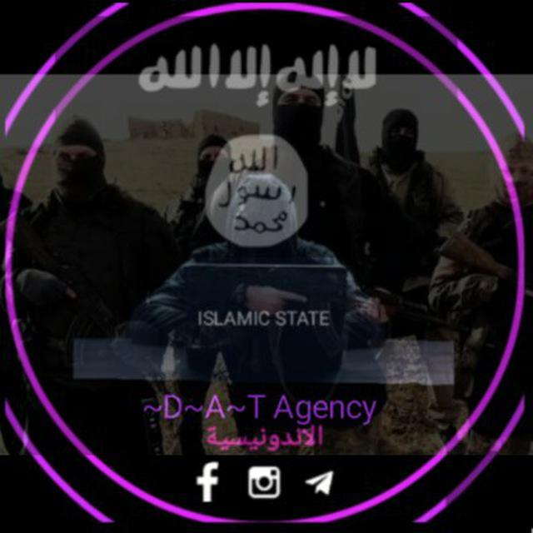


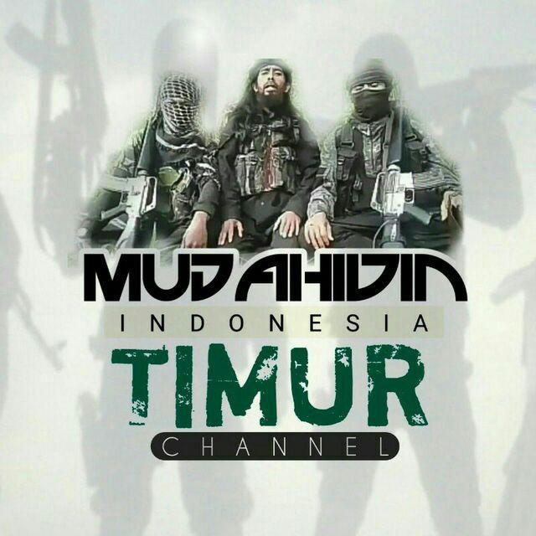


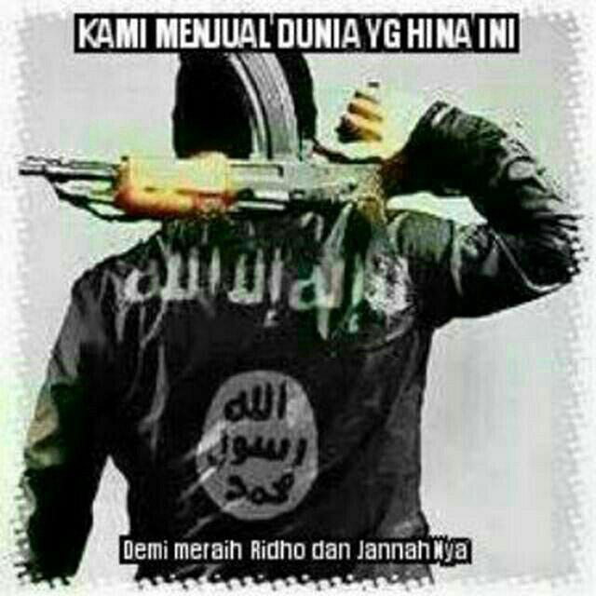






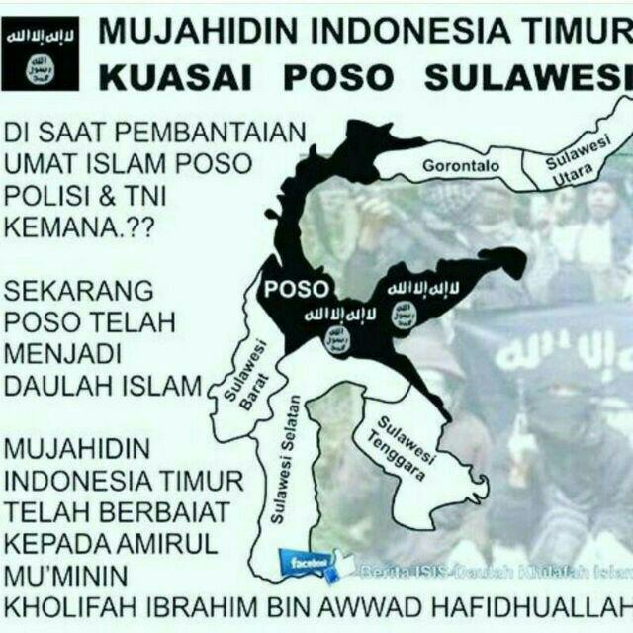
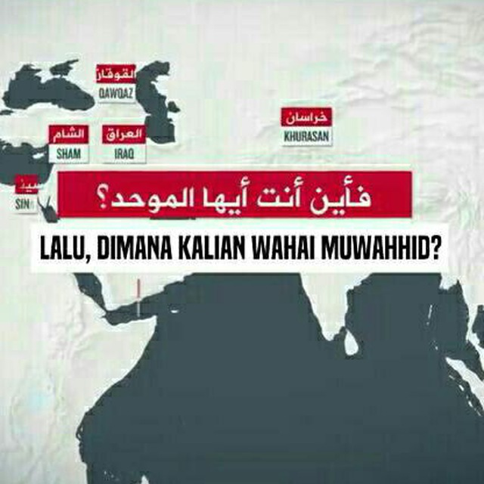


Constantly shifting environment: Online jihadists

Slide 5









Constantly shifting environment: Social media platforms

Slide 6
The Indonesian online extremist community
Online jihadists
Make threats, incite violence
Link with other online jihadists in region
Store jihadist media content online
Pro-jihad websites
NGOs
Disseminate jihadist media reports
Commentaries on jihad
Build narratives of Muslim persecution
Disseminate and translate jihadist media reports

Slide 7


Indonesian online jihadists
Threat makers

Slide 8
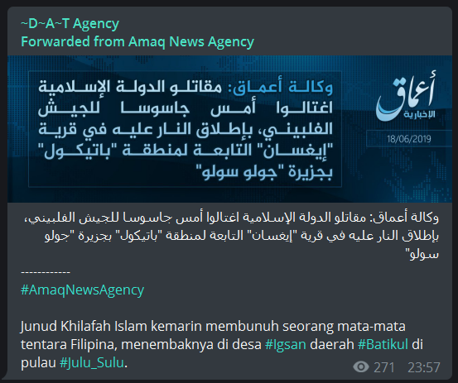
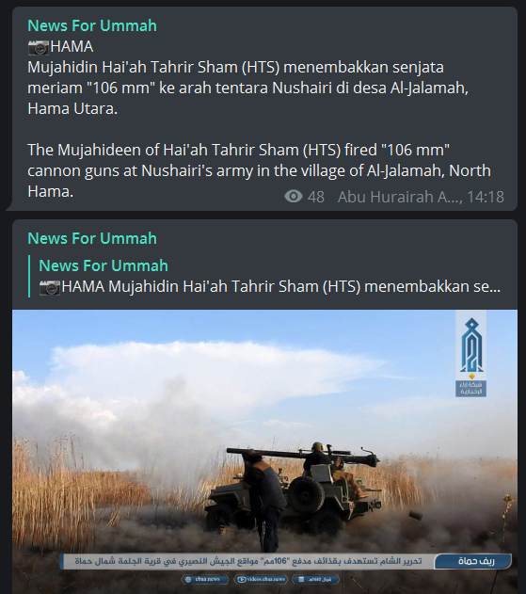
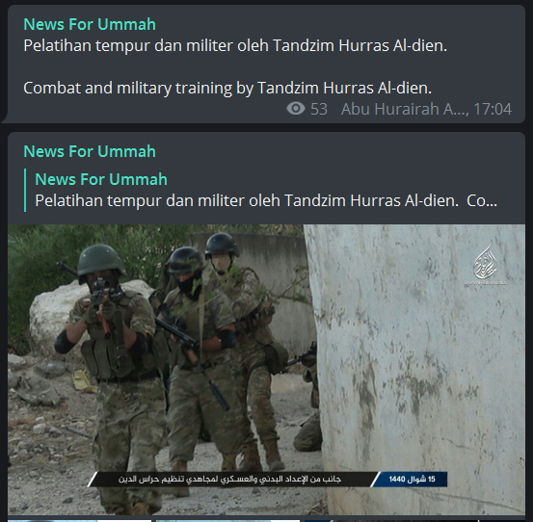
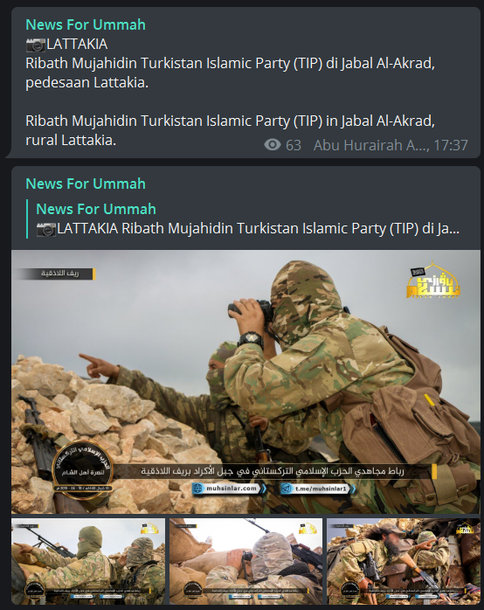
Indonesian online jihadists
Disseminators
Translating jihadist content for an Indonesian audience

Slide 9


Indonesian online jihadists
Disseminators
Providing recommendations for online security

Slide 10




Indonesian online jihadists
Linking
Diskusi Pergerakan Islam
Telegram discussion group for jihadists from Indonesia, Philippines, Malaysia, Singapore, Thailand

Slide 11
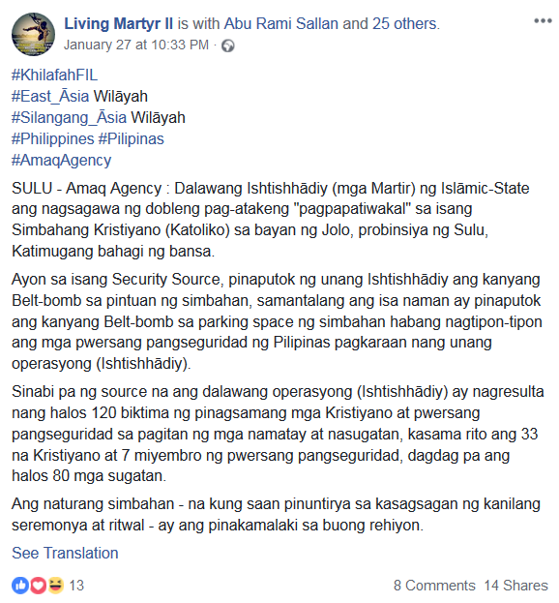

Indonesian online jihadists
Linking
Tagging
Jakarta, Indonesia
Tagging
Pattani, Thailand
Tagging
Mindanao, Philippines

Slide 12
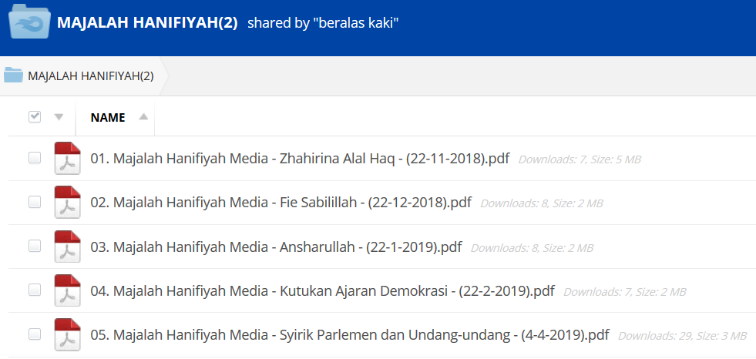
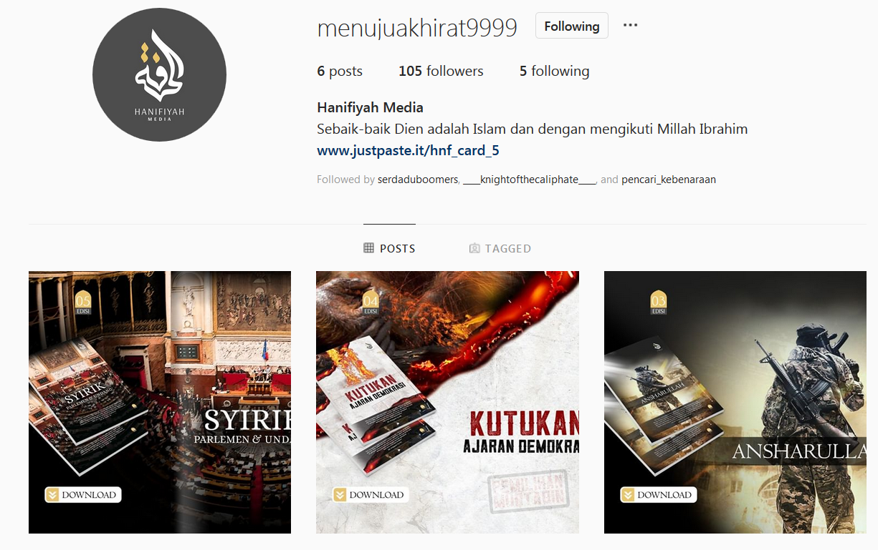
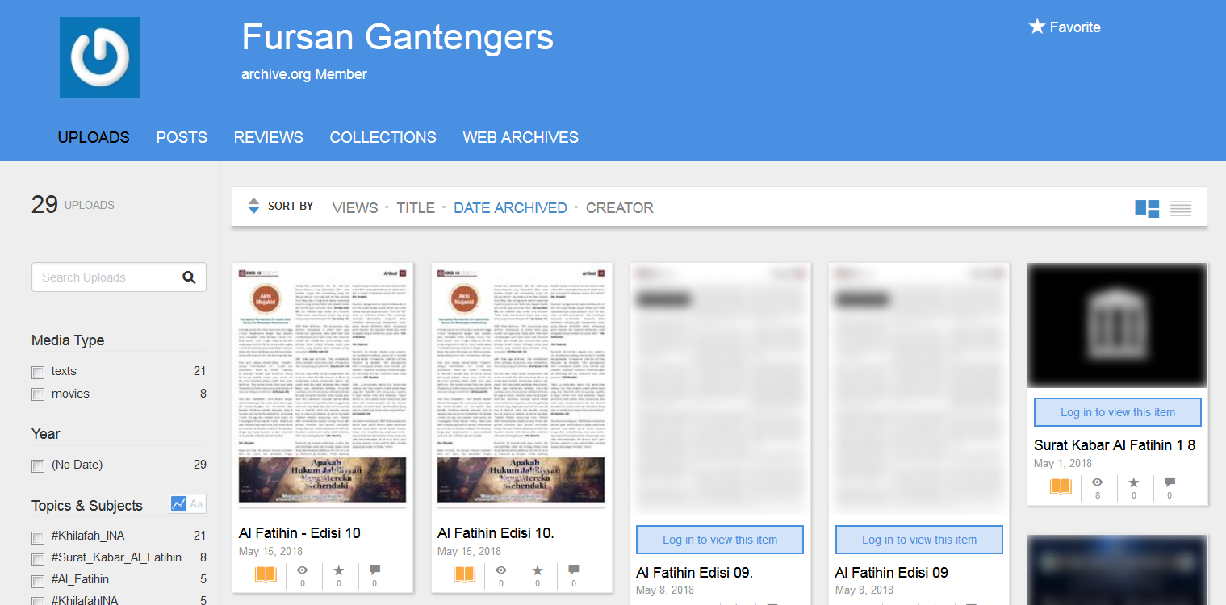
Indonesian online jihadists
Data storers

Slide 13


Indonesian online jihadists
Data storers

Slide 14
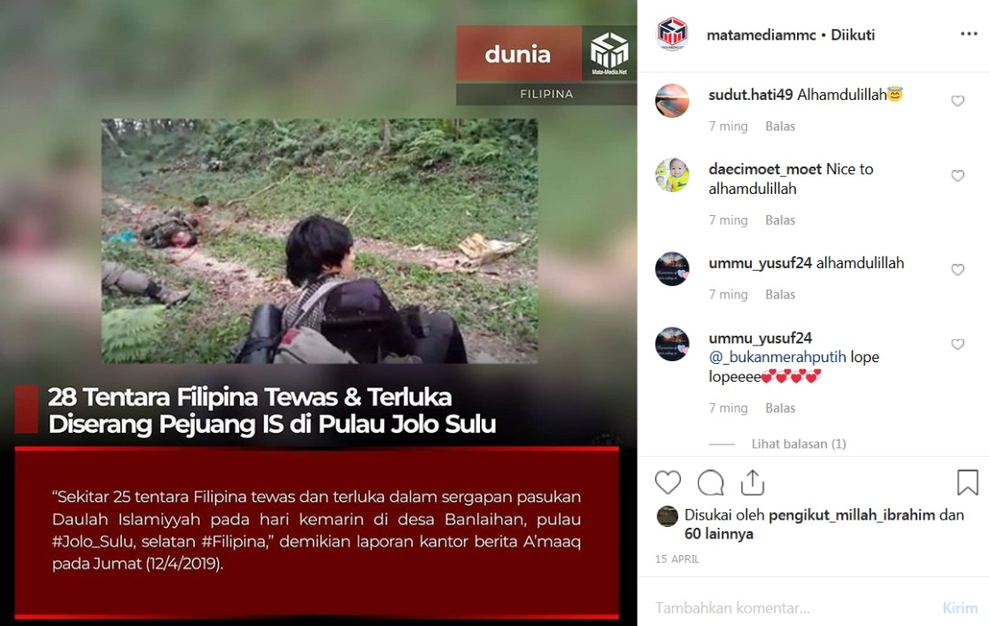

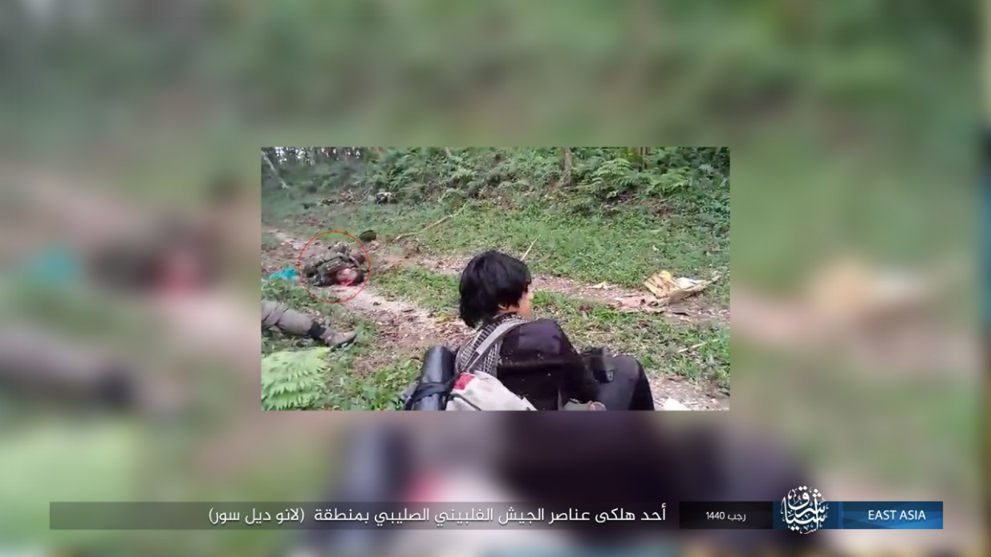
Pro-jihad webites (news)
Re-hashed from official IS content

Slide 15

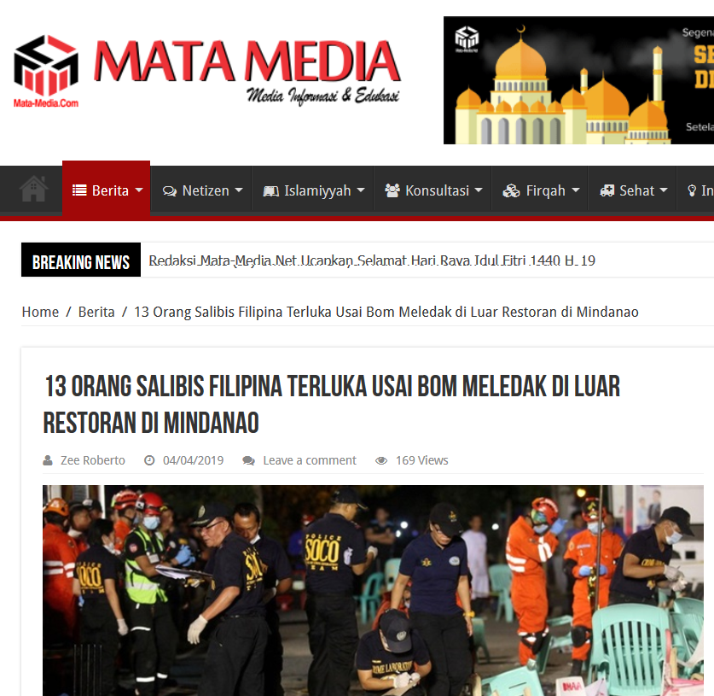
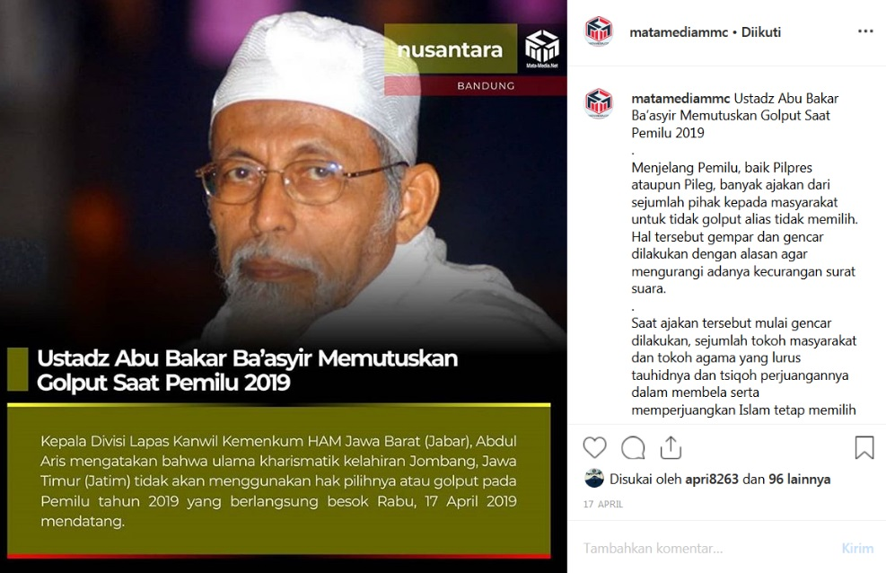
Pro-jihad websites (news)
Providing updates on jihad around the world…
…and in Indonesia

Slide 16

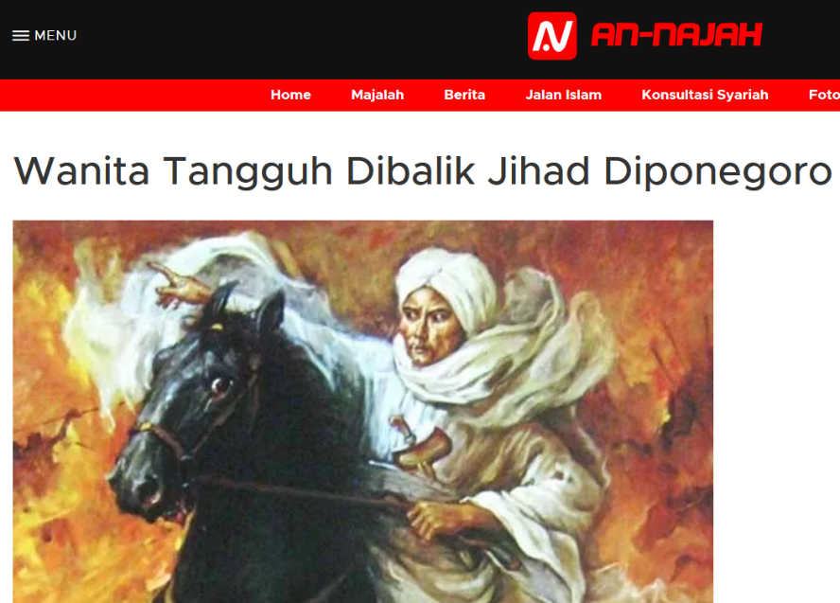

Pro-jihad websites (religious outreach)
Aligned with Jemaah Islamiyah (JI)
A product of JI’s temporary turn away from violence to expand support through religious outreach
An Najah: Emphasising role of women in jihad
Kiblat: Learning lessons of Syrian jihad
Syamina: Harkening back to ‘glory days’ of jihad
Notes:
Diponegoro jihad – reference to Java War in the 1820s, where Javanese Muslims mounted a rebellion against Dutch colonial forces.
State terrorism – underlined what the power of the state has done to Muslims in the past.
Syamina – harkening back to so-called glory days of jihad, when Muslims controlled Andalucia in modern day Spain.

Slide 17
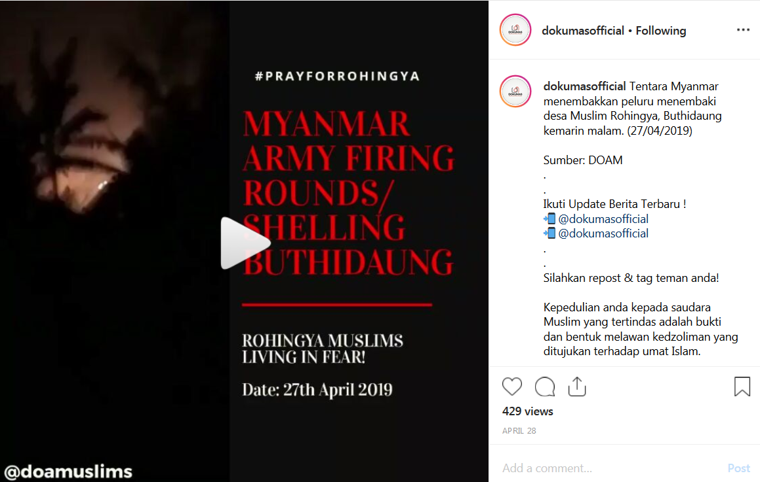

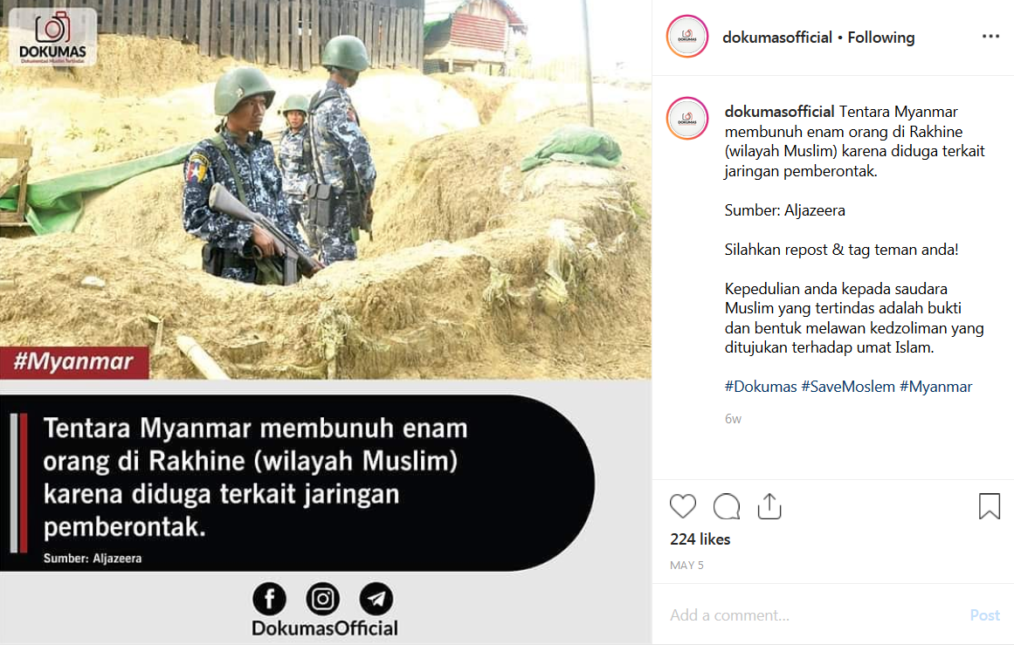
NGOs (human rights)
Does not incite violence, but builds narratives of repression against Muslims

Slide 18
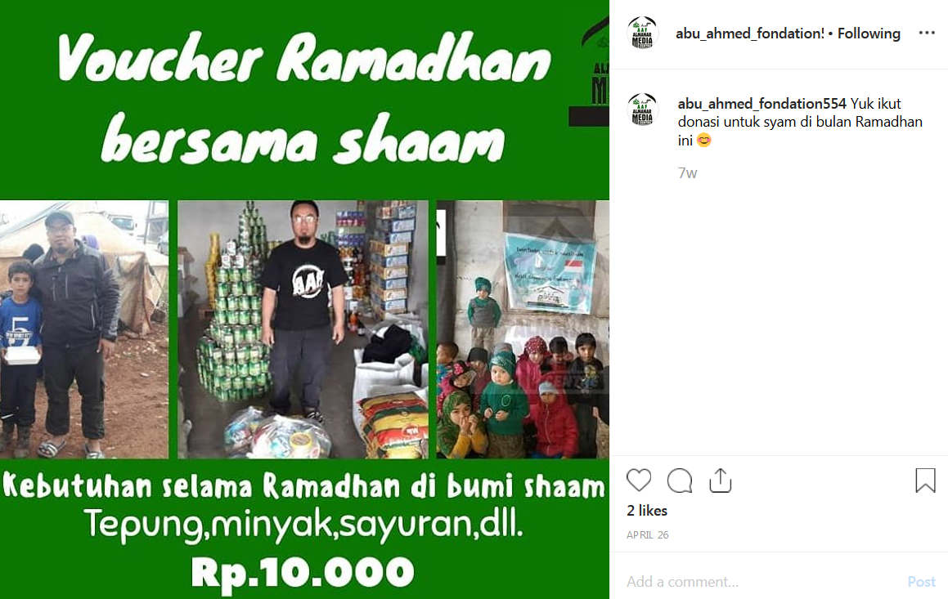
NGOs (humanitarian)

Slide 19
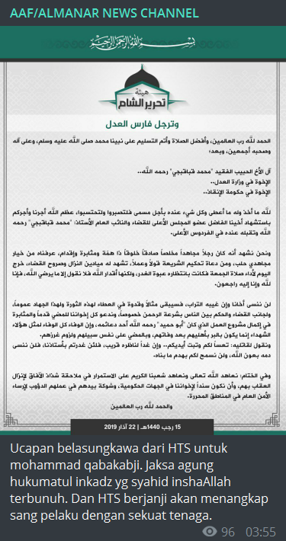
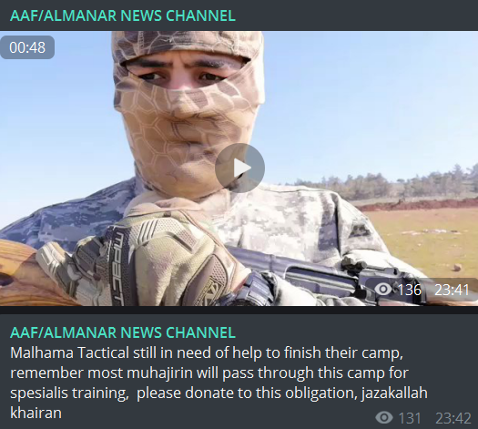
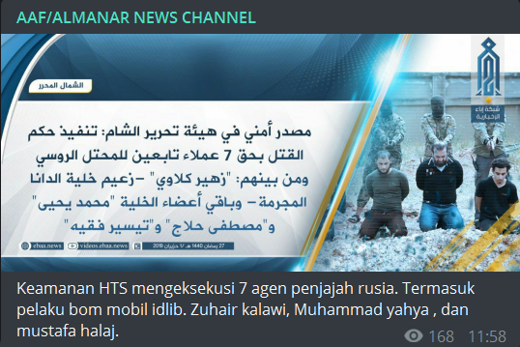
NGOs (humanitarian)

Slide 20



NGOs (humanitarian)
NGOs that raise funds to help the families of deceased or imprisoned jihadists
Promoted on pro-IS Indonesian-language channels on Telegram

Slide 21
What’s next?
More experimentation with decentralized social media platforms
  Minds social media network
Local tensions over IS’s East Asia Wilayat
  Some Filipinos reject Baghdadi – not seen this yet from Indonesians
Current lull in media environment
  Surabaya attacks, May 2018 = Last sharp rise in output

