Slide 1
CHALLENGES AHEAD
ADVANCING THE STUDY OF TERRORISM,
EXTREMISM AND SOCIAL MEDIA
J.M. BERGER
VOX-Pol Research Fellow, Swansea University Postgraduate Researcher

Slide 2
Five Theses
Violent extremism is the “root cause” of terrorism
Not all violent extremism is terrorism
Not all extremism is (materially) violent
Terrorism and extremism are two overlapping but distinct fields of inquiry; they are not the same field
Political expediency and failure of definition conflates these tracks, inhibiting research and policy advancement

Slide 3
Changing Times, Evolving Fields
Terrorism
    Tactical and material
    Relatively well-defined
    Relatively easy to interdict on social media
Extremism/violent extremism
    Strategic and less tangible
    Very poorly defined
    Controversial both to interdict and not to interdict

Slide 4
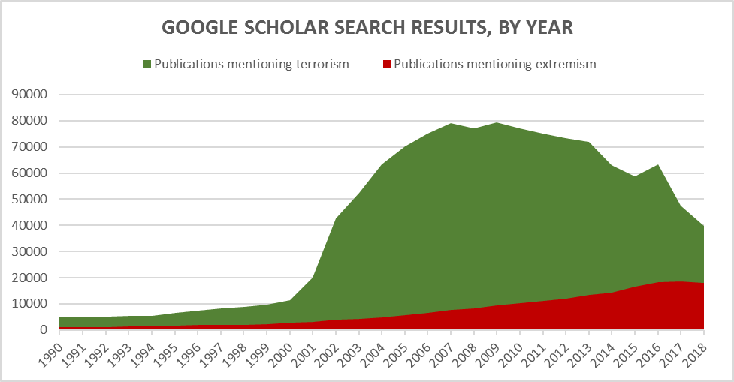
Slowly Shifting Focus

Slide 5
Defining Terrorism
General consensus around key elements:
Public violence
Advancing an ideological goal
Designed to shift/manipulate public opinion
Targeting may be symbolic or indirect

Slide 6
Defining Extremism
No consensus on key elements.
The Social Identity Theory approach:
    Extremism is used to “justify intergroup violence and … preparation for and commitment to intergroup conflict” (McCauley and Moskalenko, 2008).
    Extremism is the belief that an in-group’s success or survival is inseparable from the need for hostile action against an out-group. (Berger, 2018)
    Intergroup conflict is essential to extremism.

Slide 7
Research Consequences
Academic:
    Category errors, “terrorist propaganda”
    Comparative study and longitudinal study
    Funding streams and accountability of funders
Policy:
    Identification and labelling
    P/CVE evaluations
    Proximity to power

Slide 8
Content Moderation
Explicit (directive) or implicit (encouragement):
Content promoting intergroup bias
Content inciting intergroup conflict
Content inciting intergroup violence
Content inciting terrorism

Slide 9
Where We Go Next
Consensus on definition and boundaries of each field
Move beyond the “Islamization of extremism studies”
Articulate role of academia in policy arena
Articulate role of academia in political arena
Articulate role of policy direction in academic arena
Potential changes to funding levels, scenarios

