Slide 1
Vulnerable or just having a laugh?: Diverse youth responses to online violent extremism
Dr Julian Droogan & Ms Lise Waldek Department of Security Studies and Criminology

Slide 2
Listening to youth audiences
This ARC grant in part aims to understand the following questions:
How, why and when youth audiences consume and produce online violent extremist content
How do young people themselves define online violent extremist content?
How do they experience (emotionally and behaviourally) this type of content?
What do they do with this content and why?

Slide 3
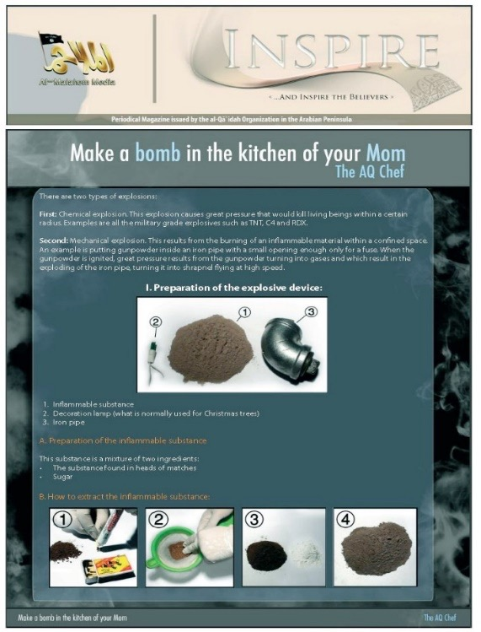

Online violent extremism research: an overview
The majority of terrorism research into online violent extremism focuses on content and content producers
Research can be categorised into three dimensions:
Instrumental usage: How violent extremists use the internet for a range of purposes including recruitment, logistics, fundraising and propaganda
Communicative usage: The aims and objectives of content; how content producers create and disseminate messages
Technological usage: The intersection of technology with instrumental and communicative aims and objectives
The above research has often relied upon a relatively one-dimensional and static conceptualization of the audience

Slide 4


Dangerous & risky: youth audiences
Online audiences have been conceptualized as vulnerable, primed to radicalisation to violent extremism often by cursory demographics including age and religion (Sageman, 2014)
Defined as uniform the influence of content on a given audience is perceived as homogenous and instantaneous (Laswell, cited in Jowell & O’Donnell, 2015)
In particular, youth audiences are often depicted as ‘at-risk’. Perceived as particularly vulnerable and highly susceptible to the risks posed by online violent extremism
The research has focused on what media does to this audience as opposed to what this audience does with media
Notes:
Online Audiences have often been conceptualized as a vulnerable mass primed to radicalisation towards violent extremism, often by cursory demographics such as age range aka youth and religious belief (Sageman 2014).
Once an audience has been defined, studies frequently perceive them as uniform, exhibiting homogenous and instantaneous emotions and behaviours (Laswell, cited in Jowett & O’Donnell 2015).
This has created perceptions of an ‘at-risk audience’ particularly in relation to ‘youth audiences’ (understood in our research as between 12-17 years of age). Lacking agency, these audiences are perceived as vulnerable and highly susceptible to the risks of radicalisation associated with consumption of online violent extremist content that has itself been defined statically as risky and dangerous by adult audiences within government and academia amongst others.
The research has focused on what media does to this audience as opposed to what this audience does with media

Slide 5
Un-silencing youth audiences
An interdisciplinary approach drawing on media and communication studies
Audiences are defined as highly dynamic consumers and producers of content. These processes occur in diverse and unexpected ways both emotionally and behaviourally
Our research draws from theories of uses and gratification
Media use is motivated by the needs and goals as defined by the audience themselves
These then influence and are influenced by the gratifications and effects associated by exposure of a given audience to content
The theory is explicitly dynamic. It recognises the agency and influence of the audience on the production, engagement and utilisation of online content

Slide 6
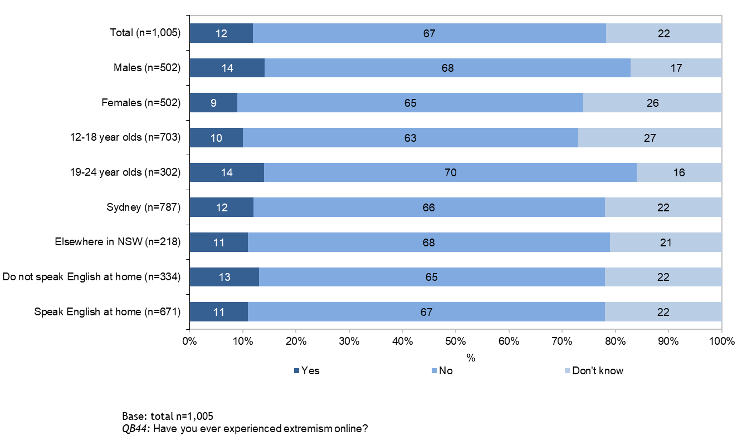
Whether children and young people have experienced extremism online
FACULTY OF ARTS | DEPARTMENT OF SECURITY STUDIES AND CRIMINOLOGY

Slide 7
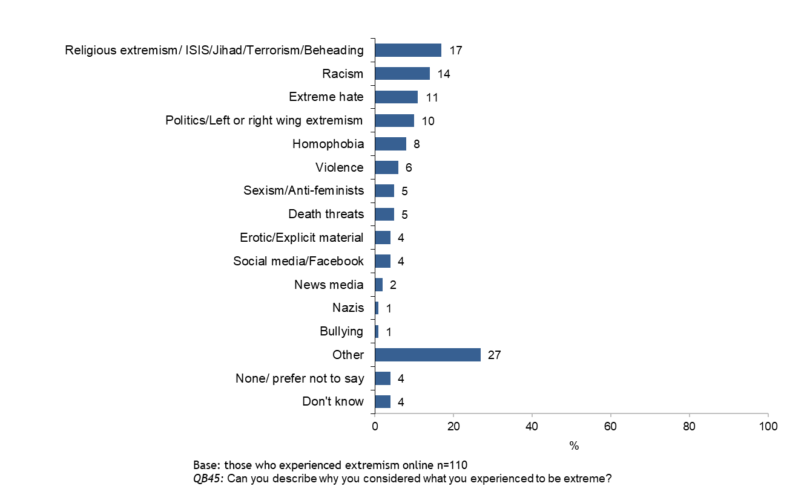
Why children and young people considered what they experienced to be extreme
FACULTY OF ARTS | DEPARTMENT OF SECURITY STUDIES AND CRIMINOLOGY

Slide 8
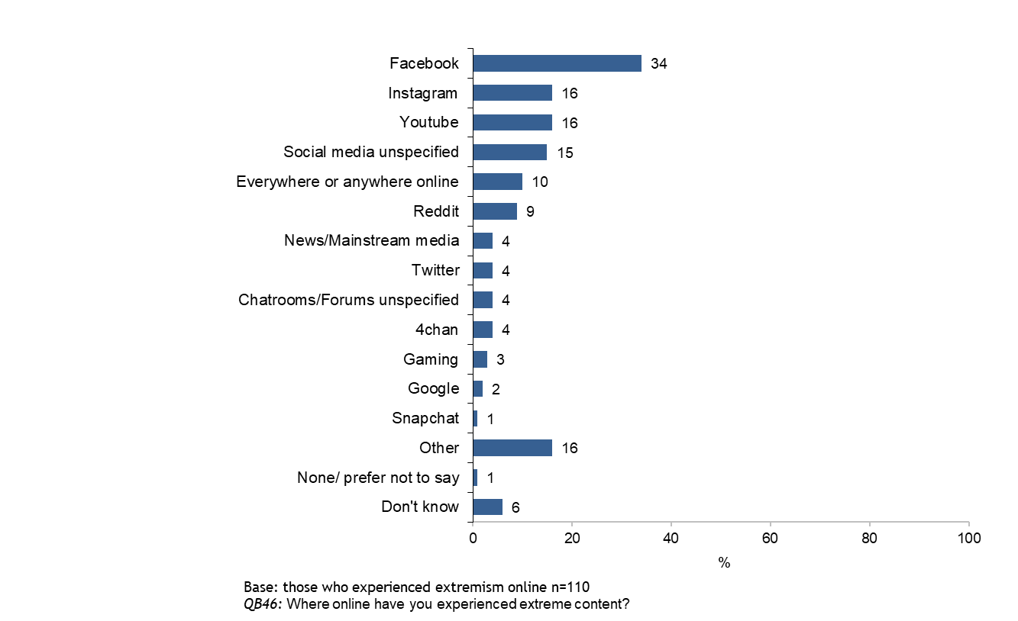
Where online children and young people have experienced extreme content
FACULTY OF ARTS | DEPARTMENT OF SECURITY STUDIES AND CRIMINOLOGY

Slide 9
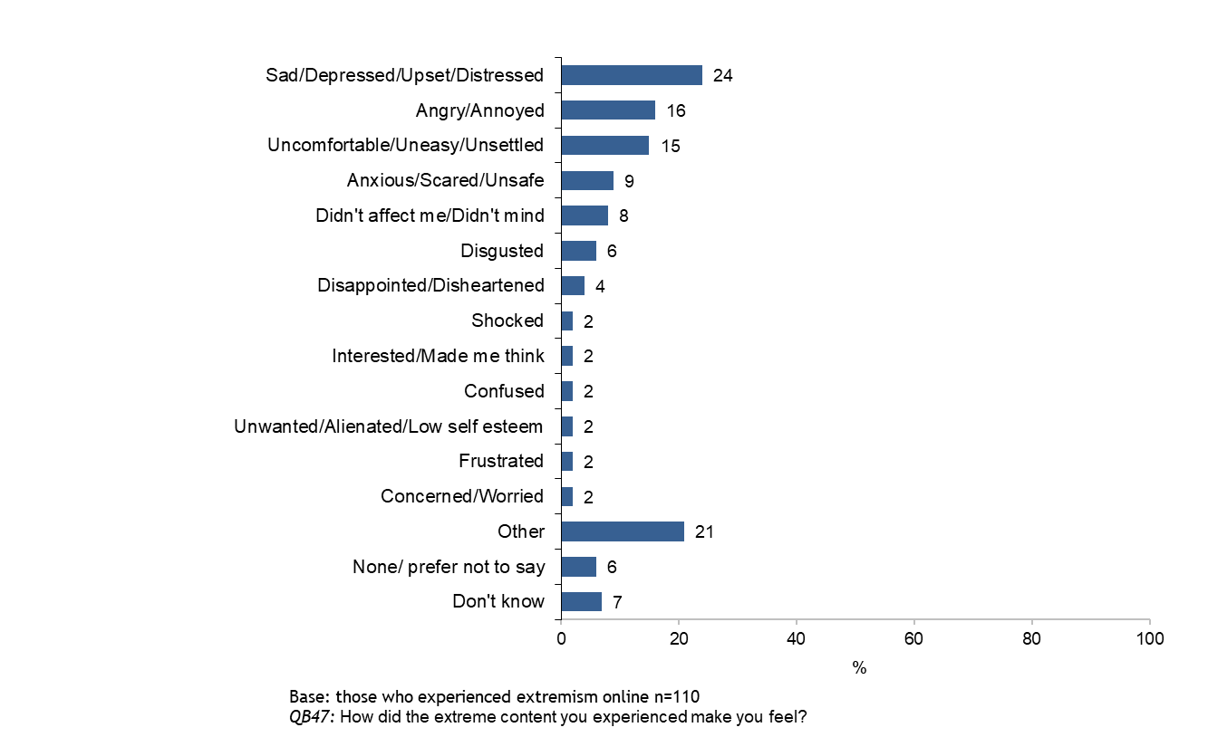
How the extreme content made children and young people feel
FACULTY OF ARTS | DEPARTMENT OF SECURITY STUDIES AND CRIMINOLOGY

Slide 10
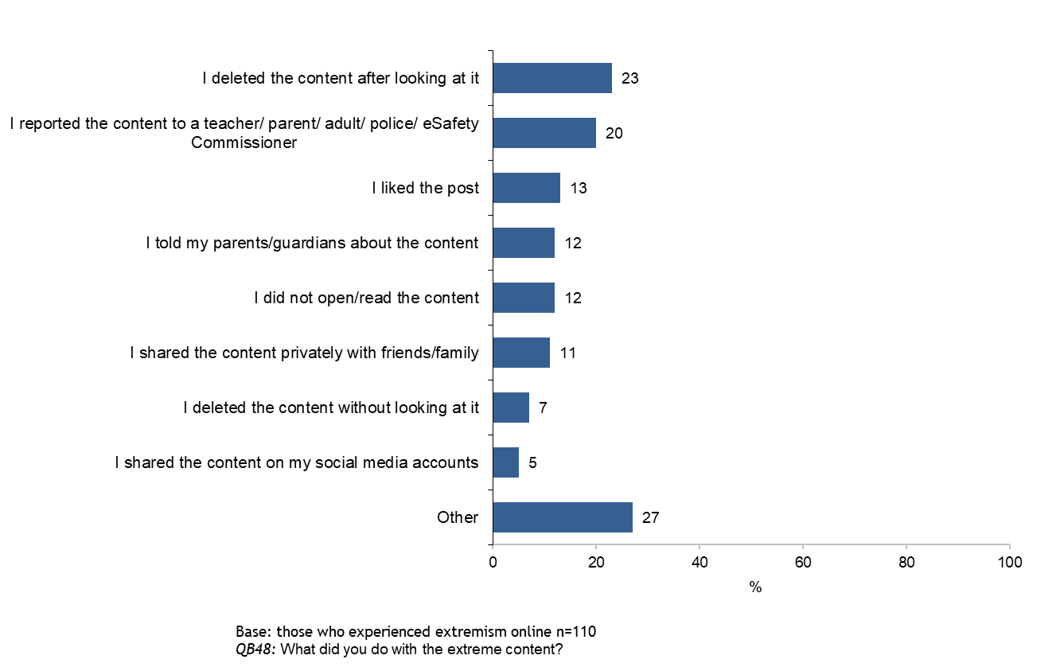
What children and young people did with the extreme content
FACULTY OF ARTS | DEPARTMENT OF SECURITY STUDIES AND CRIMINOLOGY

Slide 11
Next steps - focus groups
New High schools
Currently ethics applications to continue this research within NSW high schools are under ethics review by Macquarie University and the NSW Dept of Education
Focus groups will be carried out in six state high schools across urban and regional NSW
Focus groups with 12-17 years olds who have interest in violent extremist materials online will revolve around questions about:
Youth led considerations of what is deemed ‘violent extremist’ online
The diverse emotional responses of audiences to this content
Rationales behind ‘liking’, ‘sharing’, ‘commenting’, ‘deleting’ and ‘reporting’ materials
The individual and social context within strategies of resilience operate - i.e. how is this material shared, discussed, evaluated, interacted with, and responded to both online and offline.

Slide 12
Summary
What do we know, what must we learn?
Youth audiences are dynamic. They interact with online extremist and violent materials in a diversity of ways
Online environments blend with offline environments - 40% of young people report being online ‘continuously. This is particularly the case with the interface between social media and traditional news media - TV [63%] and online news [43%] remain the primary sources for global news; while social media [51%] and friends [50%] are the primary sources for local news
There is no agreement among young people about what counts as ‘extremist’ material online. Instead there are a diversity of interpretations encompassing religious, political and other domains
There are a diverse range of emotional as well as behavioural responses to this material
More research needs to be done into what ‘resilience’ looks like in this space - and especially the degree to which engaging with online violent and extremist materials can demonstrate strategies if resilience

Slide 13
Questions

