Slide 1
Moign Khawaja
Dublin City University (DCU)
Determining the “Stateness” of Islamic State According to their Video Propaganda

Slide 2
0. Definitions
State: “A nation or territory considered as an organised political community under one government” (Oxford Dictionary, 2017).
Weber defined the state as “a human community that (successfully) claims the monopoly of the legitimate use of physical force within a given territory” (Gerth & Mills, 1946, p. 77).
Stateness: the projection of state-like attributes such as having authority, granting rights, imposing rule of law, pursuing independent policies etc.
Sovereignty: the ability to carry out actions in a territory independently.

Slide 3
1. Introduction
IS in its heyday, from mid 2014 to late 2016, controlled vast swathes of land in north-western Iraq and north-eastern Syria.
It proclaimed statehood as a “caliphate” in July 2014, which remained unrecognised by the international community.
IS projected its “stateness” based on visual materials online such as videos, photos, infographics, magazines etc.
One of the Islamic State’s explicit goals was to attract citizens from all over the world to help build its “caliphate.”
Unparalleled appeal of IS is deeply interlinked with its visual projection of statehood.

Slide 4
2. Aims & Objectives
Important to assess IS’s “stateness” projection as it serves as a blueprint for future jihadist terror groups.
Determine “stateness” of IS according to their video propaganda while taking into account their deviations which other states would not normally commit in order to be considered a state.
Not to assess the validity of IS’s claim of statehood.
Establish that IS extensively used visual displays of statehood to project:
Sovereignty;
Gain legitimacy in the eyes of its supporters;
Sow fear & revulsion in the hearts of its enemies while also seeking their attention & reaction.

Slide 5
3. Literature Review
The “Islamic” aspect of “Islamic State” has come under intense debate:
Wood (2015) declared IS as “very Islamic” arguing that it is “impossible to understand IS without acknowledging the genuine Islamic underpinnings of the organisation” while drawing attention to the commitment to Islamic scriptures and practices espoused by IS.
Cole (2015) rejected the Islamic attributes of IS and went as far to suggest that seeing IS as an Islamic organisation is “just a form of Orientalism, a way of othering the Middle East and marking its culture as inherently threatening.”
Dagli (2015) pointed out that merely quoting from texts and evoking religious imagery are not signs of true religious following & should be labelled as “exclusivism” instead of “literal” interpretation of Islam.
Even jihadi ideologues are divided over the Islamic nature of IS and wrote lengthy treatises both in appreciation and condemnation of the Islamic credentials of the Caliphate (Bunzel, 2015).

Slide 6
3. Literature Review
However, the “State” aspect of the “Islamic State” largely remains an overlooked subject, especially in relation to the global visual politics of the Islamic State project (Anfinson, 2019).
IS has been labelled as a terrorist organisation with a “pretense of statehood” (Weiss & Hassan, 2015) while others referred IS more in the sense of a state, a particular condition, than as a nation or territory under one government (Stern & Berger, 2015; Gerges, 2016).
Anfinson (2019) analysed IS’s projection of statehood via Dabiq magazine.
Kadercan (2019) conceptualised IS’s ways in which it envisioned the relationship between space and society; and how its particular territoriality affected its military and political strategy.
My research is first of its kind analysing IS official videos en masse

Slide 7
4. Theoretical Framework
The 1933 Montevideo Convention constituted one of the first examples of insertion of ‘rights and duties’ of States in a multilateral legally binding instrument.
Whilst no express recognition was given on that occasion of their ‘fundamental’ character, rights recognised by the Convention included the right to political existence, independence, self-preservation, jurisdiction, and equality (Carbone & Pepe, 2009).
The Conference also established the standard definition of a state under international law by stipulating the following four criteria:
(i) a permanent population;
(ii) a defined territory;
(iii) government; and
(iv) capacity to enter into relations with the other states.

Slide 8
4. Theoretical Framework - A

Slide 9
Corpus
Number of Videos per Case Study
Population | 88
Territory | 84
Governance | 175
Foreign Relations | 134
Total Number of Videos | 481

Slide 10
5. Methodology
Research based on preliminary assessment of 28 videos
Selected according to their content
4 case studies based on 1933 Montevideo Convention which sets the criteria of statehood: a permanent population, a defined territory, a government, and the capacity to enter into relations with other states
7 videos each from 4 case studies (7 x 4 = 28)
MAXQDA 2018 software used for visual analysis
Videos included in the prelim. assessment were released between July 2014-July 2017 with the exception of one recent video [Inside the Khilafah 7]
All videos are releases from IS’s official media organs including Al Hayat
Multi-lingual content

Slide 11
Case Study 1 – Population
Elements
IS cleric(s)
IS child fighter(s)
IS fighter(s) [local + foreign]
Enemy leaders/population
Teenagers/Youngsters
IS engaging with teenagers/young persons
IS fighter(s) with his kid(s)
Mixed gathering [civilians + IS fighters]
IS engaging with kids
Kid(s)
IS engaging with locals
Foreign Fighter(s)
Local(s)
Consent [pledge of allegiance - Bayah]

Slide 12
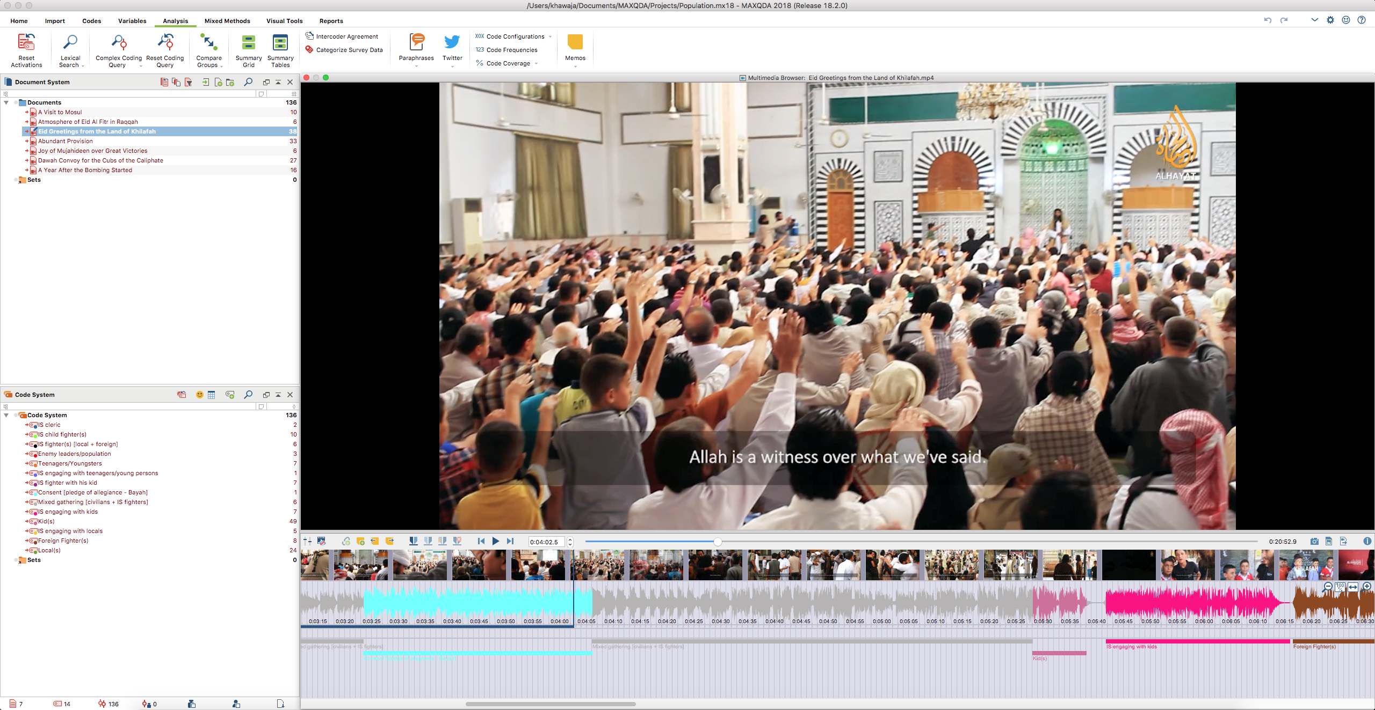
Consent
Mixed Gathering
Kids
IS engaging with kids
Foreign
fighters

Slide 13
Case Study 1 – Population
Code System | A Visit to Mosul | Atmosphere of Eid Al Fitr in Raqqah | Eid Greetings from the Land of Khilafah | Abundant Provision | Joy of Mujahideen over Great Victories | Dawah Convoy for the Cubs of the Caliphate | A Year After the Bombing Started | TOTAL
IS cleric(s) |  |  |  |  |  |  | 17% | 3%
IS child fighter(s) |  |  |  |  |  | 51% |  | 6%
IS fighter(s) [local + foreign] |  |  |  |  | 90% |  | 41% | 13%
Enemy leaders/population |  |  |  | 1% |  |  | 7% | 1%
Teenagers/Youngsters |  |  |  | 5% |  | 5% |  | 1%
IS engaging with teenagers/young persons |  |  | 10% |  |  |  |  | 3%
IS fighter(s) with kid(s) |  |  | 18% | 1% |  | 2% |  | 7%
Consent [pledge of allegiance - Bayah] |  |  | 3% |  |  |  |  | 1%
Mixed gathering [civilians + IS fighters] |  |  | 18% |  |  |  |  | 6%
IS engaging with kids |  | 19% | 6% |  |  | 4% |  | 4%
Kid(s) |  | 29% | 14% | 44% | 8% | 29% | 4% | 17%
IS engaging with locals | 36% | 10% |  |  |  |  |  | 5%
Foreign Fighter(s) | 31% |  | 40% |  |  |  |  | 17%
Local(s) | 21% | 36% |  | 38% |  | 6% | 23% | 14%
NOT CODED | 11% | 5% | 7% | 12% | 10% | 13% | 9% | 9%
CODED | 89% | 95% | 93% | 88% | 90% | 87% | 91% | 91%
TOTAL LENGTH | 100% (0:06:25.2) | 100% (0:04:17.4) | 100% (0:20:52.9) | 100% (0:07:43.4) | 100% (0:03:56.2) | 100% (0:06:42.7) | 100% (0:10:46.6) | 100% (1:00:44.6)

Slide 14
Case Study 2 – Territory
Elements
New Border(s)
War Booty
Aerial View
Journalist reporting
Enemy(ies)
Attack/Fighting
Military convoy(s)
Civilian endorsement
Border posts/boundaries/barriers/checkpoints
Maps
IS flag/leader/fighter

Slide 15
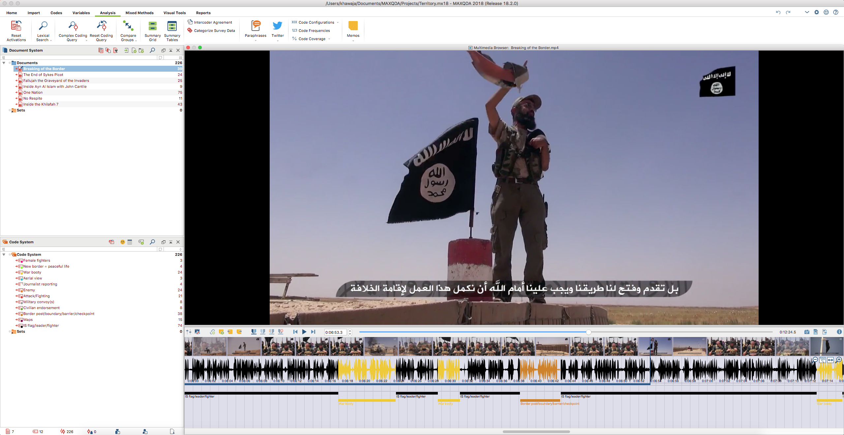
IS flag/leader/fighter
War booty
Border post

Slide 16
Case Study 2 – Territory
Code System | Breaking of the Border | The End of Sykes Picot | Fallujah the Graveyard of the Invaders | Inside Ayn Al Islam with John Cantlie | One Nation | No Respite | Inside the Khilafah 7 | TOTAL
Female fighters |  |  |  |  |  |  | 3% | 1%
New border = peaceful life |  |  |  |  | 3% | 2% |  | 1%
War booty | 7% | 28% | 30% |  | 4% |  | 4% | 10%
Aerial view |  |  |  | 22% |  |  |  | 1%
Journalist reporting |  |  |  | 66% |  |  |  | 4%
Enemy | 8% | 12% | 23% |  | 10% | 43% | 14% | 13%
Attack/Fighting | 1% |  | 34% |  | 7% |  | 37% | 13%
Military convoy(s) | 0% |  |  |  | 4% |  | 5% | 2%
Civilian endorsement | 11% |  |  |  | 11% |  |  | 4%
Border post/boundary/barrier/checkpoint | 5% | 17% | 13% | 3% | 15% |  | 1% | 9%
Maps |  | 2% |  |  | 5% | 8% | 3% | 3%
IS flag/leader/fighter | 53% | 68% | 43% | 2% | 29% | 28% | 35% | 40%
NOT CODED | 15% | 8% | 7% | 7% | 21% | 19% | 4% | 12%
CODED | 85% | 92% | 93% | 93% | 79% | 81% | 96% | 88%
TOTAL LENGTH | 100% (0:12:24.5) | 100% (0:15:03.9) | 100% (0:07:57.9) | 100% (0:05:32.6) | 100% (0:23:55.3) | 100% (0:04:13.9) | 100% (0:20:20.2) | 100% (1:29:28.6)
*Female fighters featured in an official video

Slide 17
Case Study 3 – Governance
Elements
Education
Army
Health Services
Financial Services
Hisbah (religious police)
Security Services
Policy Statements/Vox-pops
State Goals
Religious Services
Social Services
Civil Service
Bureaucracy

Slide 18
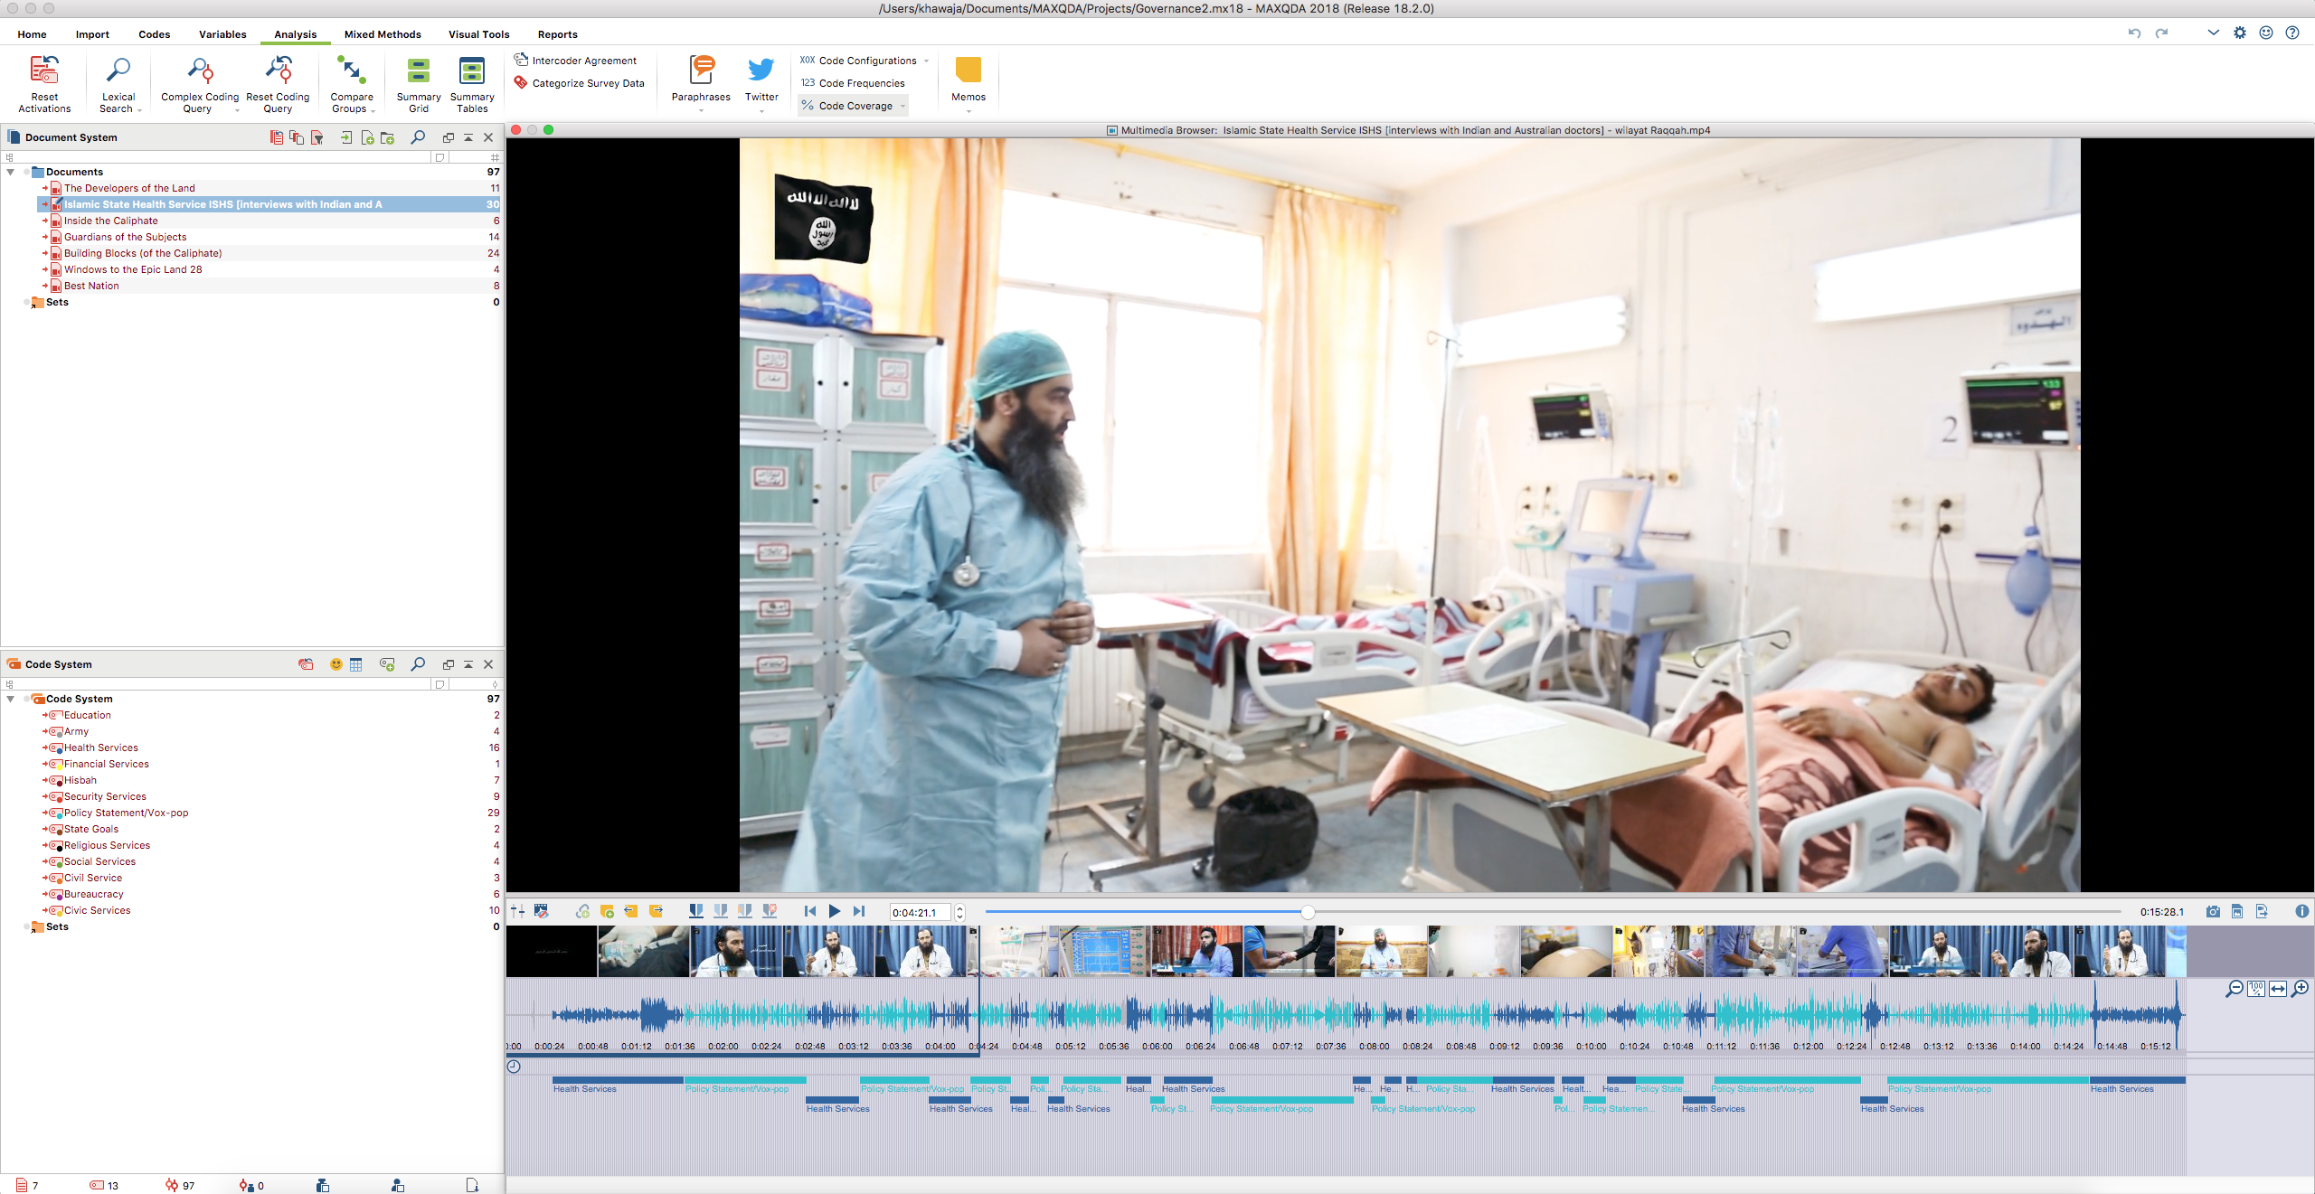

Slide 19
Case Study 3 – Governance
Code System | The Developers of the Land | Islamic State Health Service | Inside the Caliphate | Guardians of the Subjects | Building Blocks (of the Caliphate) | Windows to the Epic Land 28 | Best Nation | TOTAL
Education |  |  |  |  |  | 70% |  | 4%
Army | 25% |  |  |  | 7% | 7% | 8% | 7%
Health Services |  | 32% |  |  |  |  |  | 7%
Financial Services |  |  | 25% |  |  |  |  | 1%
Hisbah |  |  | 16% | 11% | 1% |  | 61% | 15%
Security Services |  |  |  | 47% | 3% |  | 27% | 14%
Policy Statement/Vox-pop | 23% | 58% | 7% | 21% | 19% | 9% |  | 23%
State Goals |  |  |  |  | 8% |  |  | 1%
Religious Services | 4% |  |  |  | 11% |  | 1% | 2%
Social Services | 5% |  |  |  | 11% |  |  | 2%
Civil Service |  |  | 7% |  | 2% |  |  | 1%
Bureaucracy |  |  |  | 2% | 22% |  |  | 4%
Civic Services | 11% |  |  | 14% | 12% |  |  | 6%
NOT CODED | 32% | 10% | 45% | 5% | 4% | 14% | 3% | 12%
CODED | 68% | 90% | 55% | 95% | 96% | 86% | 97% | 88%
TOTAL LENGTH | 100% (0:11:52.3) | 100% (0:15:28.1) | 100% (0:03:15.3) | 100% (0:13:30.9) | 100% (0:11:10.6) | 100% (0:04:13.8) | 100% (0:14:51.6) | 100% (1:14:22.8)

Slide 20
Case Study 4 – Foreign Relations
Elements
Enemy’s narrative (e.g. admission of guilt)
Policy statement (by former/current IS leaders)
Political issues/crises
IS solution/juxtaposition
What God/Prophet says (Quran & Hadith)
Historical narrative
Civilian voices
IS fighters/officials

Slide 21
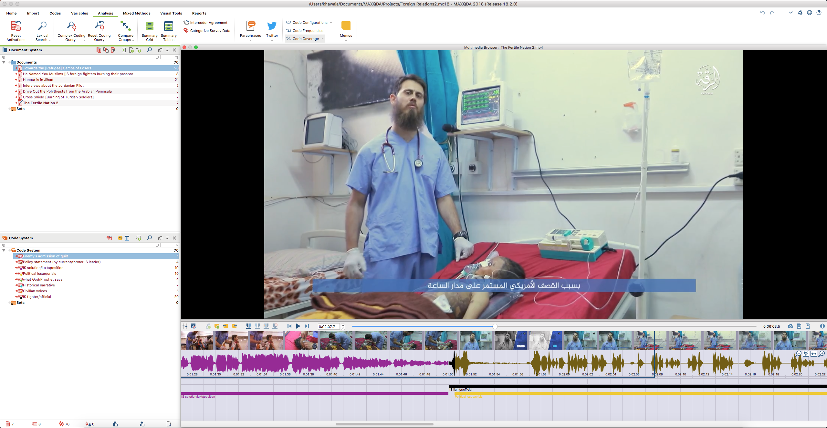

Slide 22
Case Study 4 – Foreign Relations
Code System | Towards the [Refugee] Camps of Losers | He Named You Muslims [IS foreign fighters burning their passports] | Honour is in Jihad | Interviews about the Jordanian Pilot | Drive Out the Polytheists from the Arabian Peninsula | Cross Shield [Burning of Turkish Soldiers] | The Fertile Nation 2 | TOTAL
Enemy's admission of guilt |  |  |  |  |  | 14% |  | 3%
Policy statement (by current/former IS leader) |  | 2% |  |  |  | 17% | 11% | 4%
IS solution/juxtaposition | 2% | 32% | 15% |  | 1% | 49% | 22% | 18%
Political issue/crisis | 24% |  | 6% |  |  | 2% | 27% | 9%
What God/Prophet says | 6% | 7% |  | ? | 1% | ? |  | 2%
Historical narrative | 5% |  | 20% |  | 23% |  |  | 9%
Civilian voices | 38% |  |  | 54% |  |  |  | 11%
IS fighter/official | 21% | 60% | 49% | 37% | 60% | 37% | 70% | 44%
NOT CODED | 4% | 2% | 16% | 10% | 16% | 24% | 40% | 14%
CODED | 96% | 98% | 84% | 90% | 84% | 76% | 60% | 86%
TOTAL LENGTH | 100% (0:21:34.5) | 100% (0:12:31.2) | 100% (0:20:44.4) | 100% (0:04:55.2) | 100% (0:15:26.8) | 100% (0:19:00.2) | 100% (0:06:03.5) | 100% (1:40:16.0)

Slide 23
6. Observations
Uncoded segments of the videos mostly intros & collages
Overlapping elements
Switches between elements
Women have featured in IS videos albeit rarely and fully clad in burqas
Female fighters shown on camera fighting IS’s enemies in video entitled “Inside the Khilafah 7” perhaps first and the last time

Slide 24
7. Key Findings
Emergence of a certain story-telling pattern in IS videos in all criteria
IS (sub)conscious of the conditions of modern state despite opposing the Westphalian state model
Spectacular projection of state giving impression of functioning govt., cordial civilian-IS administration ties, expanding territory & clear policies
Insistence on the “one & only” + “us vs them” narrative
Kids feature heavily in IS videos
Civilian voices also depicted albeit in approval/support roles
Rules based on what God/Prophet says but also supplanted by official policy/solution when doesn’t suit narrative e.g. burning of the Jordanian pilot

Slide 25
Contact me
Thank you!
Feedback & suggestions most welcome ☺
Email: moign.khawaja@outlook.com
Twitter: @moignkhawaja

