Slide 1

The importance of research ethics and the codes we should abide by:
By Ingrid Pritchard
Chair – School of Health and Social Care Research Ethics Committee

Slide 2

Aims
This presentation will introduce you to important ethical principles within research.
It will then discuss some of the most notorious research studies that have been conducted and explain why they are ethically dubious.
It will introduce you to key ethical documents that have been produced as a result of these studies. Documents such as the Nuremberg Code, the Belmont Report and the Declaration of Helsinki are still applicable today.
It will end with how you can ensure an ethical study.

Slide 3
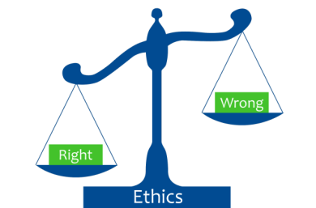
Objectives
By the end of this presentation you should be able to:
Critically discuss what an ethical argument is.
Justify the need for an ethical approach when conducting social or medical research
Explain why certain research studies harmed participants.
Discuss and evaluate key ethical codes and documents.
This Photo by Unknown Author is licensed under CC BY-SA-NC
Notes:
3

Slide 4

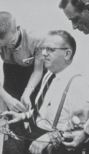
Disclaimer
Please be aware that some of the links in this presentation discuss and depict sensitive topics. The clips are only intended for adults.
This Photo by Unknown Author is licensed under CC BY-NC-ND

Slide 5
Ethics and social research
All research involving human participants should adhere to ethical principles.
These include the following 4 ethical principles: autonomy, beneficence, non-maleficence and justice.
Additionally, researchers should also consider: the importance of informed consent, deception and privacy.
Notes:
5

Slide 6
Principlism: the 4 ethical principles.
Further information on these can be accessed by reading Beauchamp and Childress.
Beauchamp, T, L. and Childress, J.F (2019) Principles of Biomedical ethics (8th edn). Oxford University Press.

Slide 7

Autonomy
All adults with mental capacity are able to make their own decisions and can govern their life.
In terms of research, it means that the researcher must ensure all relevant information is provided so the participant can make an informed decision as to whether to participate in the study.
A participant should never be coerced into participating or remaining within a study.
Informed consent should be obtained.
(Enshrined in the Nuremberg Code 1947, the Belmont Report 1976, with revisions 1978 and the Declaration of Helsinki, 1964- to be discussed further below).
This Photo by Unknown Author is licensed under CC BY

Slide 8
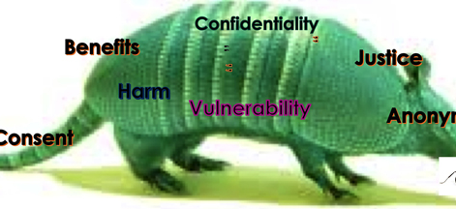
Beneficence
This ethical principle means to do good.
It may not always be easy to explain how the participant will benefit from the study, however, there should be more benefits than risks.
The Nuremberg Code 1947 emphasised how no research should be conducted where the risks would outweigh benefits.
The Declaration of Helsinki 1964 stated ‘The participant's well-being should be paramount over the interests of science and society.’
A reward or incentive may be offered to a participant but the researcher must make it clear that it is not a form of coercion. A book token or voucher can be used as a suitable incentive.
This Photo by Unknown Author is licensed under CC BY

Slide 9
Non-maleficence
This ethical principle means to not harm.
No research participant should be harmed by participating in a research study.
If the risks outweigh the benefits then it is unlikely the study is ethical.
First emphasised within the Nuremberg Code 1947 due to the atrocities committed against humanity.

Slide 10

Justice
This ethical principle when applied to research means that all research participants should be treated fairly and equally. In context this means that all participants should be treated the same and be provided with all relevant information throughout the study.
It also means that researchers working in a team should ensure that all members of the team should be treated fairly.
For example; it would be unethical for one researcher to publish an article as theirs and not provide recognition of other members of the team.
This Photo by Unknown Author is licensed under CC BY-NC-ND

Slide 11

What harms could occur?
There may be considerable debate as to what causes harm. It could be physical or psychological. However, any researcher needs to consider the potential for harm to participants and limit it.
There are several infamous cases where harm has occurred to participants. Yet, harm can occur in any research study not just the infamous ones. For example; researchers wanted to study how survivors of ITU felt. Participants were interviewed about their memories.
It would seem that there was little harm involved as participants were interviewed in their homes, there was no physical intervention and participation was voluntary. However, during the interviews some painful memories were unlocked, and the researchers then needed to arrange counselling and follow-up visits to ensure psychological harm was limited.
This Photo by Unknown Author is licensed under CC BY-NC-ND
Notes:
11

Slide 12
The documents that enshrine the ethical principles for research
This section will now discuss the following:
The Nuremberg Code 1947
The Declaration of Helsinki 1964
The Belmont Report (first raised in 1972, published in 1976 with further revisions and additions 1978).

Slide 13
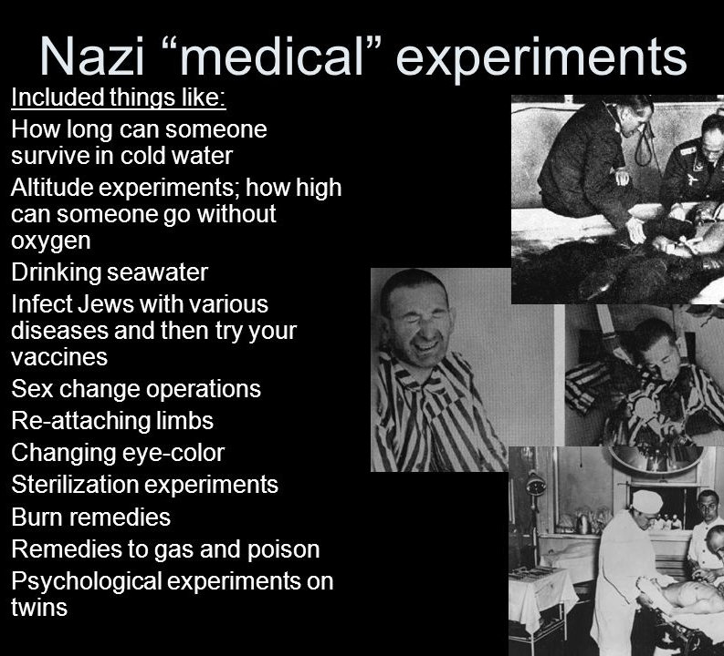
Nuremberg Code 1947
This followed some horrendous research studies where physicians were convicted of crimes against humanity.
It was introduced to ensure that any research involving human participants would abide by ethical codes.
It created 10 rules that all researchers should abide by: see https://www.google.com/search?client=safari&rls=en&q=10+rules+of+nuremberg+code&ie=UTF-8&oe=UTF-8
Notes:
13

Slide 14
The Nuremberg code endorsed the following:
Principles of informed consent
Absence of coercion
Properly formulated experimentation
Beneficence to participants
Risk/benefit analysis
Avoidance of all unnecessary physical or mental suffering and injury
Notes:
14

Slide 15
Informed consent- falls under the umbrella of autonomy
There should be consent from participants. This should be given on a voluntary basis and free from coercion.
The Nazi war crimes forced participants into medical experimentation.
There are very rare occasions when informed consent may not be sought. Strict justification would be needed.
Notes:
15

Slide 16
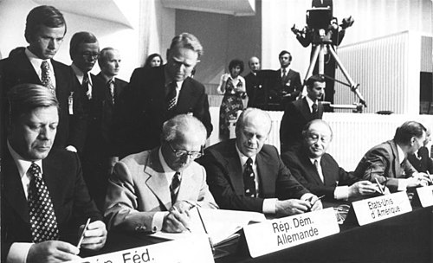
The Declaration of Helsinki
First created in 1964 by the world medical association. Numerous updates since including Edinburgh in 2000.
Consent should be in writing
Limited use of placebo
Greater access to benefit
The participant's well-being should be paramount over the interests of science and society.
This Photo by Unknown Author is licensed under CC BY-SA
Notes:
16

Slide 17
Deception
Deception can occur if you present your study as something other than it is. The Tuskegee Syphilis Study and Milgram studies being classic examples.
Deception may also occur if researchers falsify data, plagiarise or even omit results if it disproves/proves their initial aim.
Notes:
17

Slide 18
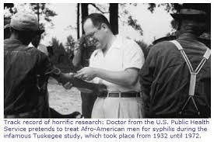
Tuskegee syphilis study (1932-72).
Did not adhere to the Declaration of Helsinki or the Nuremberg code.
For more information please see Tuskegee Study - Timeline - CDC – OS
Notes:
18

Slide 19
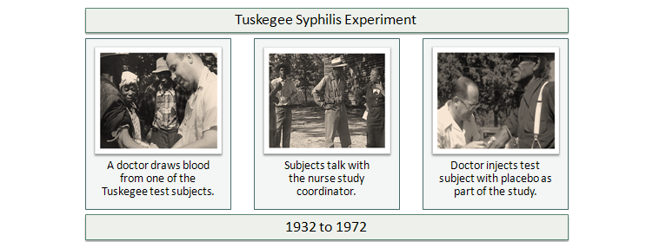
TSS
Notes:
19

Slide 20
TSS
This study deliberately lied to its participants and prevented them from getting actual treatment. Penicillin had become available shortly after it started.
The men in the study were told they were receiving the treatment for ‘bad blood’. The health professionals wanted to investigate how full blown syphilis could affect people.
Therefore, it physically harmed, deceived and violated their right to consent. The study was stopped in 1973 due to national outcry. It did not adhere to any ethical principles.
Notes:
20

Slide 21
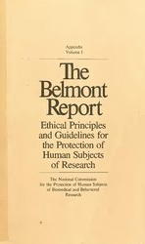
Belmont Report
In 1972 the public became aware of the TSS
The National Commission for the Protection of Human Subjects of Biomedical and Behavioural Research was established
1976-78; Belmont Report published by the National Commission. This endorsed the ethical principles of Autonomy, Beneficence and Justice.
This Photo by Unknown Author is licensed under CC BY-SA
Notes:
21

Slide 22
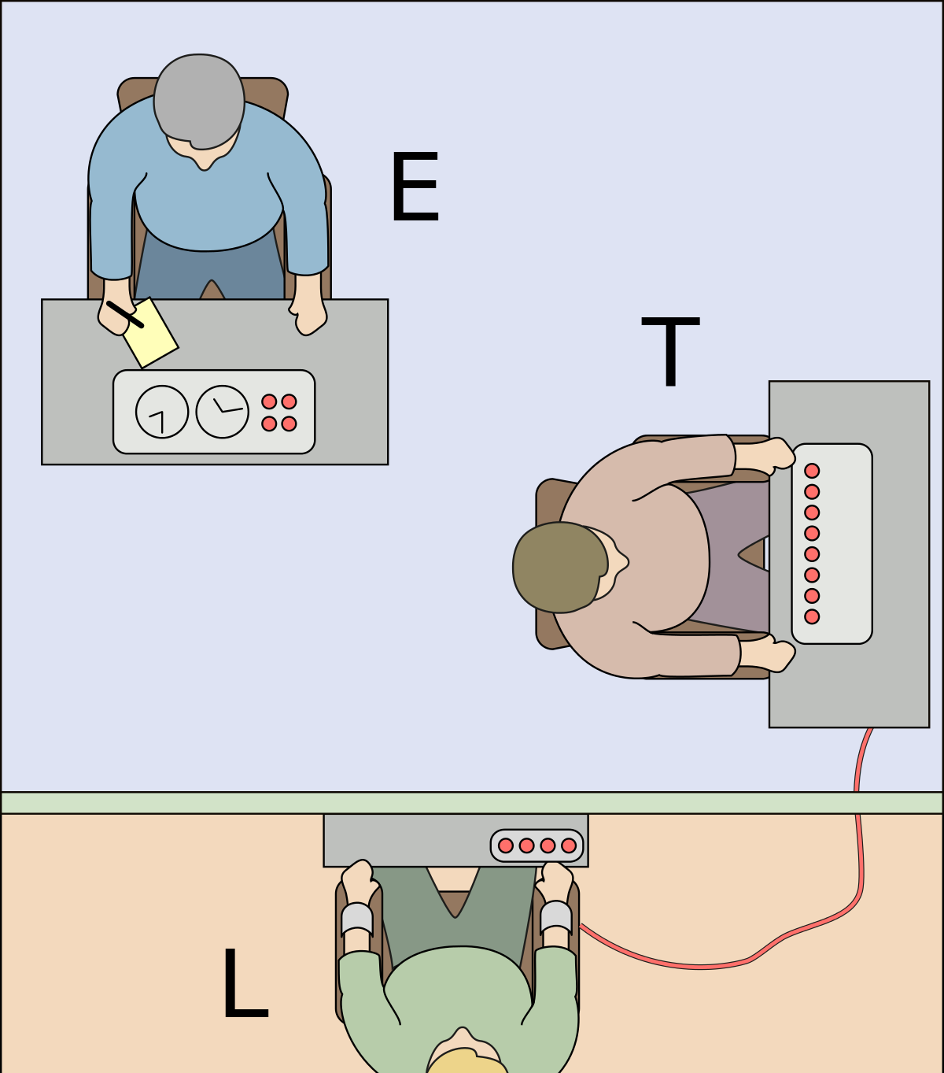
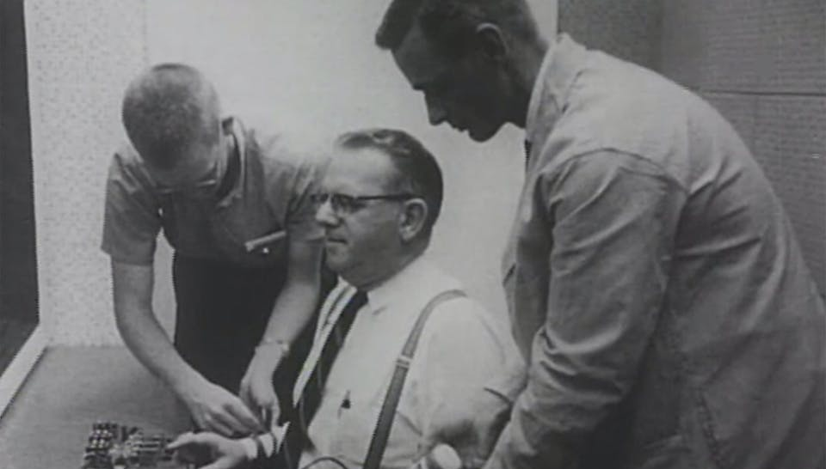
Milgram’s study
Another case of deception is the ‘Obedience to Authority’ study.
Conducted by Stanley Milgram to investigate how people would be obedient to someone in authority
Participants thought they were delivering electric shocks to ‘learners’ that answered wrong questions (the learners were actors).
It was found that most people would not question orders from people in authority even when the actors were in pain.
Milgram argued that it revealed that the atrocities committed by the Nazis could happen again. Ironically, he did not consider the psychological impact on his actual participants.
This Photo by Unknown Author is licensed under CC BY-SA
This Photo by Unknown Author is licensed under CC BY-SA

Slide 23
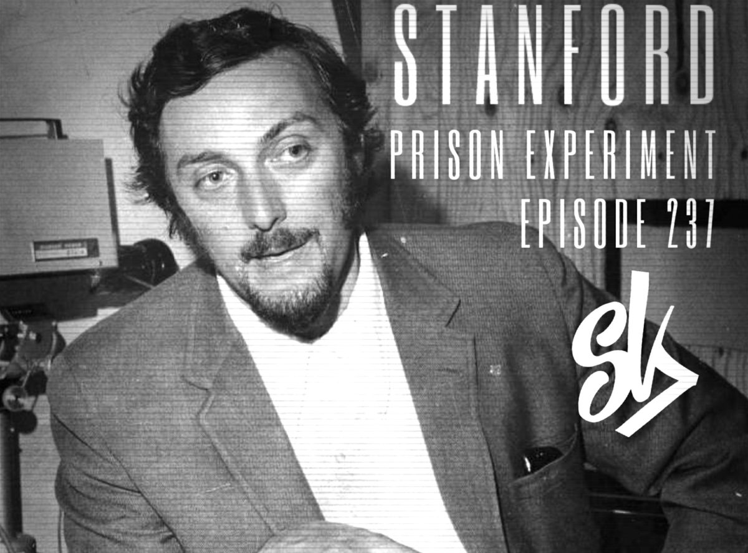
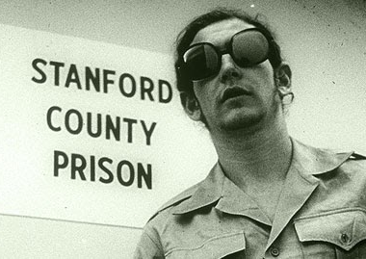


Stanford prison experiment
An infamous study that had to be abandoned due to the abuse that quickly occurred. There were allegations of physical, psychological and even sexual humiliation abuses within the first few days.
This Photo by Unknown Author is licensed under CC BY
This Photo by Unknown Author is licensed under CC BY

Slide 24


The Stanford prison experiment.
The following video explains and depicts the ‘experiment’. Please note this contains some graphic scenes.
It is included here as the research team will explain how they were so engrossed in the study that they did not see how abusive it had become. They only recognised it when an outsider pointed it out.
https://www.youtube.com/watch?v=sZwfNs1pqG0
This Photo by Unknown Author is licensed under CC BY-SA-NC
This Photo by Unknown Author is licensed under CC BY-SA

Slide 25
Covert research
Covert Research may occasionally be permissible. Informed consent may not be sought due to researchers wanting to investigate the participants in a natural setting eg: Ethnography
No participant must be harmed though as a result!

Slide 26
Invasion of privacy
Covert research may invade a person's privacy.
One US study that was criticised was by a woman who pretended to be a prostitute in a brothel to see what it was like for the women that worked there. She would observe the women being selected by visiting men and interview them afterwards.
The manager of the brothel and women were aware of her status, but the 'johns' were not.
She was criticised for not gaining their consent and potentially invading their privacy. However, they were not the sole purpose of the research. She did not keep any data on them. She was interviewing and observing the women only.
Notes:
26

Slide 27
Avoiding misconduct
Before the research ensure:
A clear research plan is made.
A risk/benefit analysis is made
Submit the plan to the ethics committee for review
Decide on the team, design and authorship
Notes:
27

Slide 28
Avoiding misconduct
During research;
Follow the ethical protocol
Ensure consent is gained and adheres to ethical/legal principles
Regularly check data
Ensure participants are free from harm
Answer any queries participants may have
Check the research team is adhering to the ethical principles
Notes:
28

Slide 29
Avoiding misconduct
After research:
Check data prior to publishing
Follow-up participants if necessary and arrange support if needed (as in Itu study)
Check all ethical and legal principles were adhered to throughout the study.
Ensure all authors are acknowledged
Notes:
29

Slide 30
Further reading/ useful websites
Social research association produces ethical guidance; http://the-sra.Org.Uk/wp-content/uploads/ethics03.Pdf
The Belmont Report belmontreport.Pdf
The Declaration of Helsinki declaration of helsinki | 1964 | britannica
The Nuremberg Code the nuremberg code (cirp.Org)
The Stanford prison experiment website stanford prison experiment
Notes:
30

