Slide 2
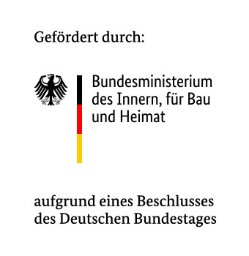
Monitoring a periphery of extremism - Education of disintegration in Online Dawah Videos on German YouTube.
Till J Baaken
@tillbaaken
@modus_zad

Slide 3
What is the periphery of extremism
  Channels in question peddle:
    Anti-democratic
    Anti-pluralist
    Intolerant narratives
    That challenge the existing order
    But never openly call for violence

Slide 4
Why the periphery of extremism
  narratives are normalised to the viewer through repetition
  frame alignment is taking place
  narrative fidelity is established
  Islamist propaganda cannot be understood without comprehending both Muslim faith and Islamic culture

Slide 5
Methodology and Limitations
  mixed-methods approach of qualitative and quantitative research methods employing an exploratory sequential design
  legitimate religious conservative viewpoints, legitimate criticism of politics vs incitement of hate, authoritarianism, anti-pluralist and anti-constitutional content

Slide 6
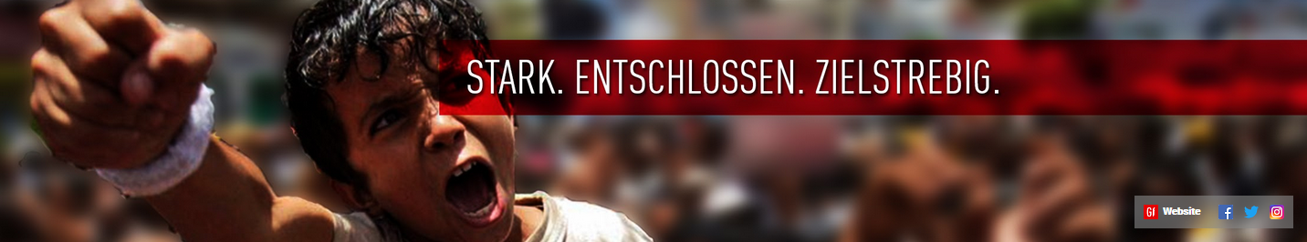
Islamist Dawah
  Dawah constitutes activities, which in Christian contexts fall under the term “missionary activities.”
  1. Diagnostic framing
  2. Prognostic framing
  3. Identifying the enemy
  → There is only halal or haram

Slide 7
Network map
  The network of the channels forms an echo chamber that so far has not been penetrated by counter narratives.
  Several channels fulfil a function of a gateway to the periphery content, knowingly or unknowingly
  A closer look:
  https://www.cluster.
  news/modus/

Slide 8
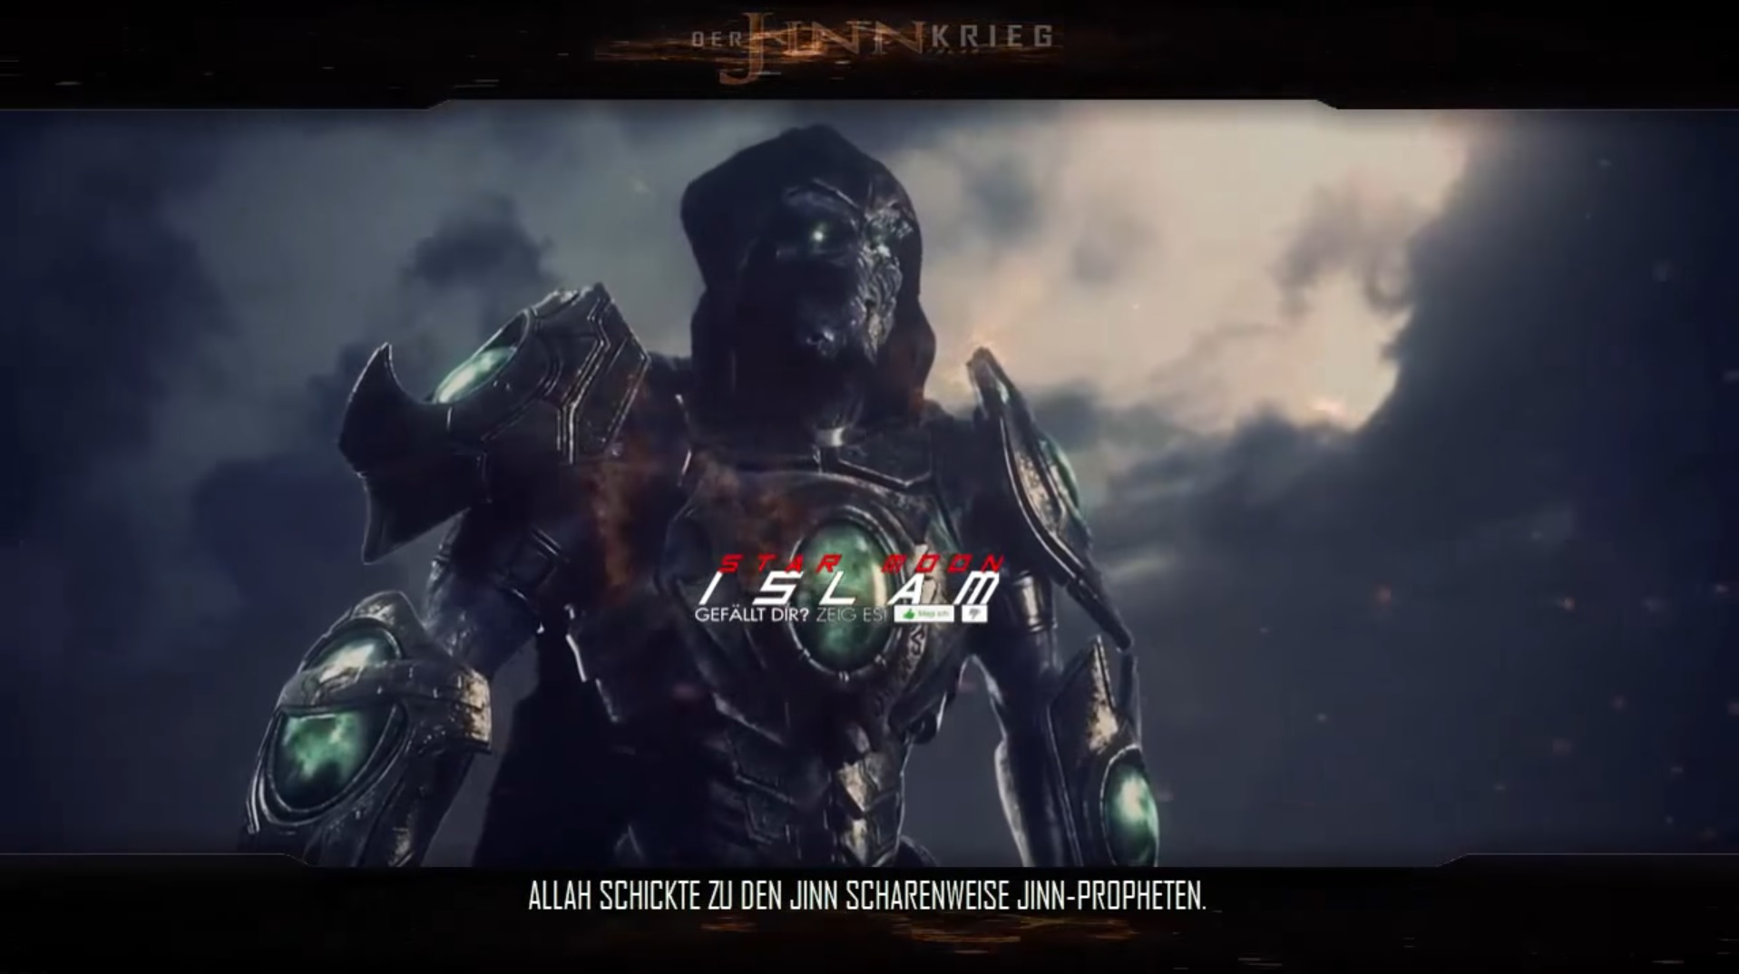
Epic Storytellers
  mix ancient stories with pop cultural references and graphics known to the target group, hence aligning the frames for more extremist content.

Slide 9
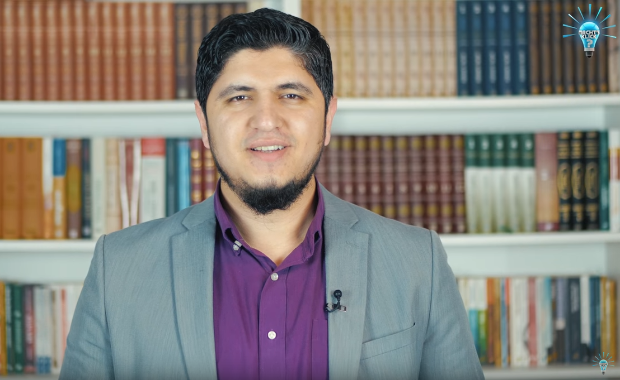
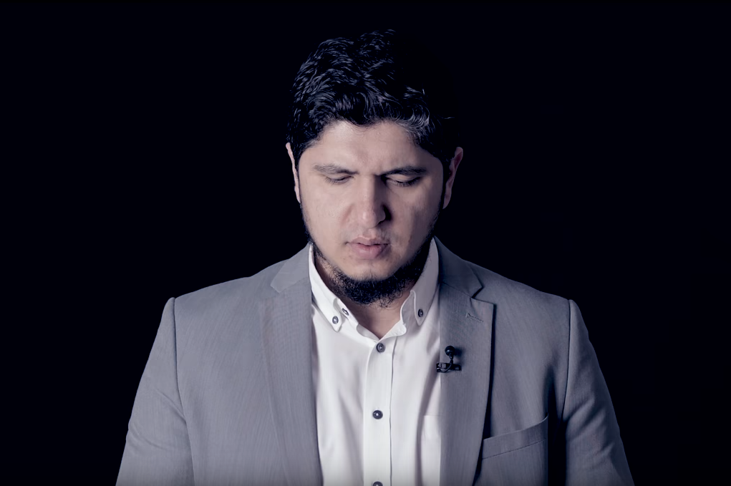
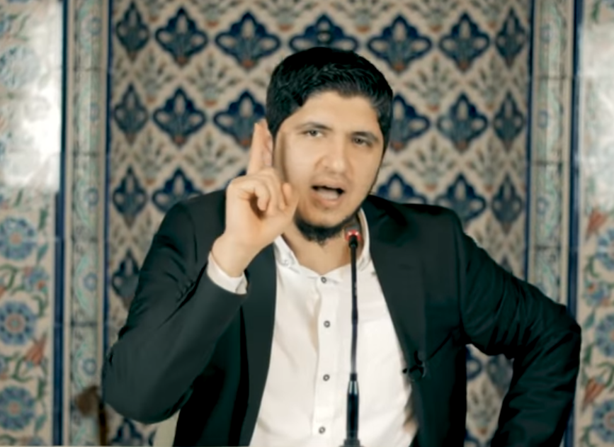
The chameleon
  using explanatory videos, emotional appeals or a classic preacher look.
  videos like “he left me” are used to find people with cognitive openings susceptible to the content.

Slide 10
Preliminary findings
  The periphery of Islamist extremism uses framing techniques to try and align the worldview of the viewers with its own.
  The network of the channels forms an echo chamber that so far has not been penetrated by counter narratives.
  Analysing the videos of the producers and copying their style and topics may be very successful. Adjusting to the familiar video types of the target groups using the frames can penetrate the echo chamber and deliver the counter message in the content.
  The echo chamber is enforced by the recommendation “Up next” algorithm of YouTube.
  Imagery, content and music is most likely copied from actors in the United Kingdom. For German counter narrative campaigns this can prove to be an distinct advantage, as style and format trends can be detected early and implemented in a counter narrative campaign
  Gender-specific addressing of the target group turns out to be of great importance.
  Deleting channels in the periphery of extremism has the opposite of the intended effect. Content reappears on smaller channels and the deleted actor gains popularity.

